Slide 1
Welcome!
You are about to take an important step.
This class will help acquire academic, career, and employability skills.
I am Rob Whinnery.
This is Chuck Butler.
Get ready to take the bull by the horns.

Slide 2
Agenda
Learn about Hiawatha Valley Adult Basic Education (ABE)
Review Enrollment Process and Fill out registration forms
Take a learning style assessment and computer skills inventory
Take CASAS learning assessment to assess your current skill level
Set Career and Learning Goals
Choose a class that meets your needs

Slide 3
Hiawatha Valley Adult Basic Education
New Student Orientation

Slide 4
Welcome to Hiawatha Valley Adult Basic Education
ABE is the acronym for Adult Basic Education.
ABE classrooms include different types of learners.
Students seeking to improve math and reading for entry to college and technical school, those seeking a GED, many seeking Career Readiness skills (computers), and others may need to learn to read.

Slide 5
Enrollment Requirements
Students must:
Not be enrolled in a public or private high school and be 16 years of age or older
Be able to commit to 30-40 hours of instruction(our experience is that it takes 30-40 hours to achieve most goals)
Need a H.S. diploma, GED®, want or need to brush up basic literacy skills for further education or job entry
Student may be enrolled in college level classes while studying in ABE (Adult Basic Education)

Slide 6
Types of Classrooms
There are two types of classrooms allowing for students to study two different ways
- The traditional classroom
- The online classroom

Slide 7
The Traditional Classroom
The ABE classroom is most often like what you remember as a “lab or study hall” setting
Breaks and snack/beverage policies vary – check with your instructor for guidelines
Cell phones should be turned off while in the classroom

Slide 8
Attendance Requirements
The Traditional Classroom instructors will discuss an attendance plan with you.
  - in order for you to have a successful learning experience you will need to attend class two times per week
  - If you fail to attend after one month you will be required to re-enroll

Slide 9
The Online Classroom
This classroom is mostly an at-a-distance learning program that is accessed via the internet
- Key Train
- i-Pathways
Enrollment is based on:
- eligibility requirements
- access to a computer and internet connection
Ask your counselor how to get enrolled if you are interested

Slide 10
Attendance Requirements
The Online classroom instructors will discuss an attendance plan with you:
  - in order for you to have a successful learning experience you will need to attend one or two classes per month, plus a distance learning orientation class.
- This class requires that you spend 4-6 hours per week on your assigned lessons (which is the same time required to take a face-to-face class).
- If after two weeks of no hours recorded, you will be locked out of the program until you make a new arrangement with your instructor.

Slide 11
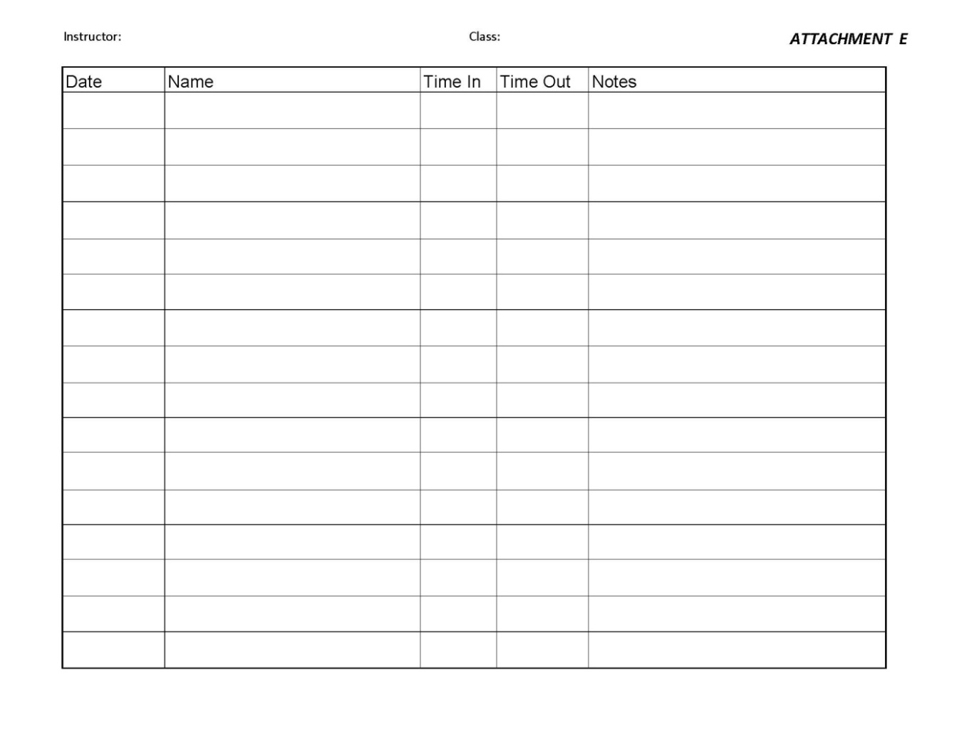
Attendance Sign-In Sheet

Slide 12
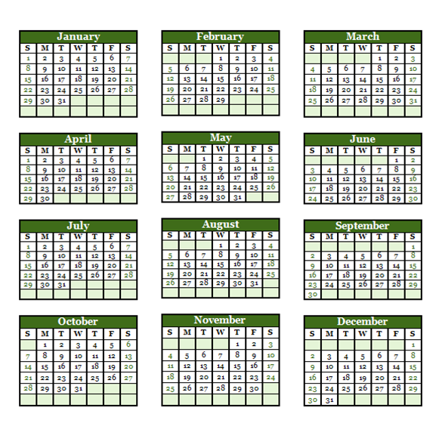
Class Dates

Slide 13
Appraisal and CASAS Assessment
After completing the forms in your student intake folder, you will be given a two-part test
- Part 1 : The CASAS Appraisal
- This test assesses your skills allowing the instructor to administer the correct level of the CASAS Assessment (Part 2) it takes 20-25 minutes

Slide 14
Appraisal and CASAS Assessment
Part 2: CASAS Assessment Pre and Post Tests
- These tests are designed to assess your skills and grade levels.
- There are math and reading assessment tests.
- The CASAS tests take about an hour to finish.

Slide 15
Appraisal and CASAS Assessment
You might be asking ….. Why all this testing?
The initial assessment, the CASAS pre-test, is important because:
It provides necessary information for setting personal and education goals
Instructors use the scores to select appropriate class and study materials

Slide 16
Appraisal and CASAS Assessment
The CASAS post-testing is used to track your progress in math and reading and helps assess readiness for the GED® Test
Post-testing occurs monthly, and at a minimum after the fall, spring, and summer sessions
We realize testing is intimidating for many, your skills may not be where you want them to be, but- REMEMBER…. CASAS assesses current skills not your abilities

Slide 17
The GED® Test
The GED® Test is a two-part, 8-hour exam
You will be tested in five subject areas:
- Reading
- Social Studies
- Science
-Math
-Writing
Your instructor will explain the scoring of these subtests and requirements for passing

Slide 18
The GED® Test
Registration Information
-Red Wing is an official GED® testing center
- test are also given in Zumbrota and Cannon Falls periodically
Prior to the test date, students must register for the test in person by:
- filling out an application form
- providing two forms of ID, one must be a photo ID
- paying the current GED® testing fee

Slide 19
GED Completion Checklist
Name_____________________________
Step 1
_____ Apply for government issued photo ID, if needed
Step 2
_____ CASAS pre--test (required by MN Dept. of Ed.)
_____ Pass GED Official Practice Tests – score of 450 or above
(500 or above is recommended if college bound)
_____ Writing _____ _____ _____
_____ Social Studies _____ _____ _____
_____ Science _____ _____ _____
_____ Reading _____ _____ _____
_____ Math _____ _____ _____
Step 3
_____ Apply for age waiver, if under the age of 19
Step 4
_____ CASAS post-test before taking GED exam (required by MN
Dept. of Ed.)
Step 5
_____ Complete registration and make appointment to test
must have ID and $80.00
for the test fee
_____ Receive confirmation of test date and time
Step 6
_____ Pass the GED exams
_____ Writing _____ _____ _____
_____ Social Studies _____ _____ _____
_____ Science _____ _____ _____
_____ Reading _____ _____ _____
_____ Math _____ _____ _____
Step 7
Enjoy the benefits of having a GED Certificate
CONGRATULATIONS!!

Slide 20
Goal Setting
There are many factors to consider when beginning a learning program and setting goals. Start by determining your own definition of success and plan accordingly to be successful in achieving those goals.

Slide 21
Goal Setting
Allow the following questions to help you think about areas that could help or hinder your plan:
What topics from this session would you like to discuss with your instructor?

Slide 22
Goal Setting
Attendance and commitment are important to achieving a learning goal
2. What obstacles or problems do you currently face that might prevent you from attending class?

Slide 23
Goal Setting
3. Identify problems or areas of your life that could prevent you from being successful in this program.
4. What steps can you take to address these “Roadblocks to Success?”

Slide 24
Roadblocks to Success
I don’t know anyone
I can’t fill out forms
I can’t pay for child care
I’m not smart enough
I’m too old to learn
I have too many family problems
I can’t learn without somebody helping me
My spouse/boyfriend/ guardian won’t like it
I can’t get here
I don’t have time
I don’t like school
I don’t like to learn this stuff
I have health problems

Slide 25
Goal Setting
5. What strengths or abilities do you have that will help you be successful in meeting your goals?

Slide 26
ABE Personal Education Plan
Column One
Instructor___________________
ABE Site___________________
Student Name_______________________
Last grade level attended_______________
Student short term/long term goals:
___Upgrade reading skills
___to read to someone else
___reading comprehension
___reading speed
___other:_____________________
___Upgrade writing skills
___grammar and usage
___spelling
___other: _____________________
___Upgrade math skills
___budgeting, balancing
checkbook, etc.
___addition/subtraction
___multiplication/division
___decimals/fractions
___other:______________________
___Upgrade social studies skills
___geography: maps/charts/graphs
___history: US and world
___Upgrade science skills
___Life science
___Earth and Space science
___chemistry/physics
___Pass the written driver’s permit test
___Improve critical thinking skills
___Improve computer/keyboarding skills
___Improve interviewing & job
application skills

Slide 27
ABE Personal Education Plan
Column Two
___Pass one or more GED subtests
___Language Arts Reading
___Language Arts Writing
___Science
___Social Studies
___Mathematics
___Improve English speaking skills
___Improve English reading skills
___Improve English writing skills
______________________________
Benefits to reaching goals:
___Ability to continue education
___Increase employability
___Get a job promotion/better job
___Raise self-esteem
___Have less fear of change
___Ability to set higher goals
___Other:_____________________
______________________________
Obstacles to completing goals:
___Single parent ___Child care
___Transportation
__Learning disability __Physical disability
___Low self-esteem
___Fear of change
__Non-supportive family member
___No short/long range goals
___Chemical dependency
___Other:_____________________
__________________________________
Start date to reach goals:_____________
Goal 1:____________________________
___1 mo. ___2 mos. ____3 mos. or more
Goal 2:____________________________
___1 mo. ___2 mos. ____3 mos. or more
__________________________________
____I agree to complete assessment tests
in reading and/or math.
____I agree to attend class at least 12
hours or more.
__________________________________
Student signature
Date: ____________________________

Slide 28
Class Expectations
Review and commit to the suggested schedule in your Hiawatha Valley Adult Basic Education Handbook
Choose class type, dates, and commit to attend first class
Fill-out Registration Forms
Take CASAS pre and post tests and VARK Learning Styles inventory
Start setting goals for your career and learning

Slide 29
Registration Forms
To start the registration process you will complete several forms in the student intake folder
Let’s go over the forms in the folder to understand the purpose of each
Open your folder, but please do not fill anything out until your counselor instructs you to

Slide 30
Registration Forms
Find the Student Handbook, which is designed to provide important information:
- Student Eligibility
- Enrollment and Attendance policies
- Assessment and Learning options
- Classroom expectations

Slide 31
Registration Forms
Find the White MARCS enrollment form
-This form will enroll you in Adult Education through HVABE
Find the Purple Student Self-Assessment form
- This form asks for a lot of information about you and your prior leaning experiences

Slide 32
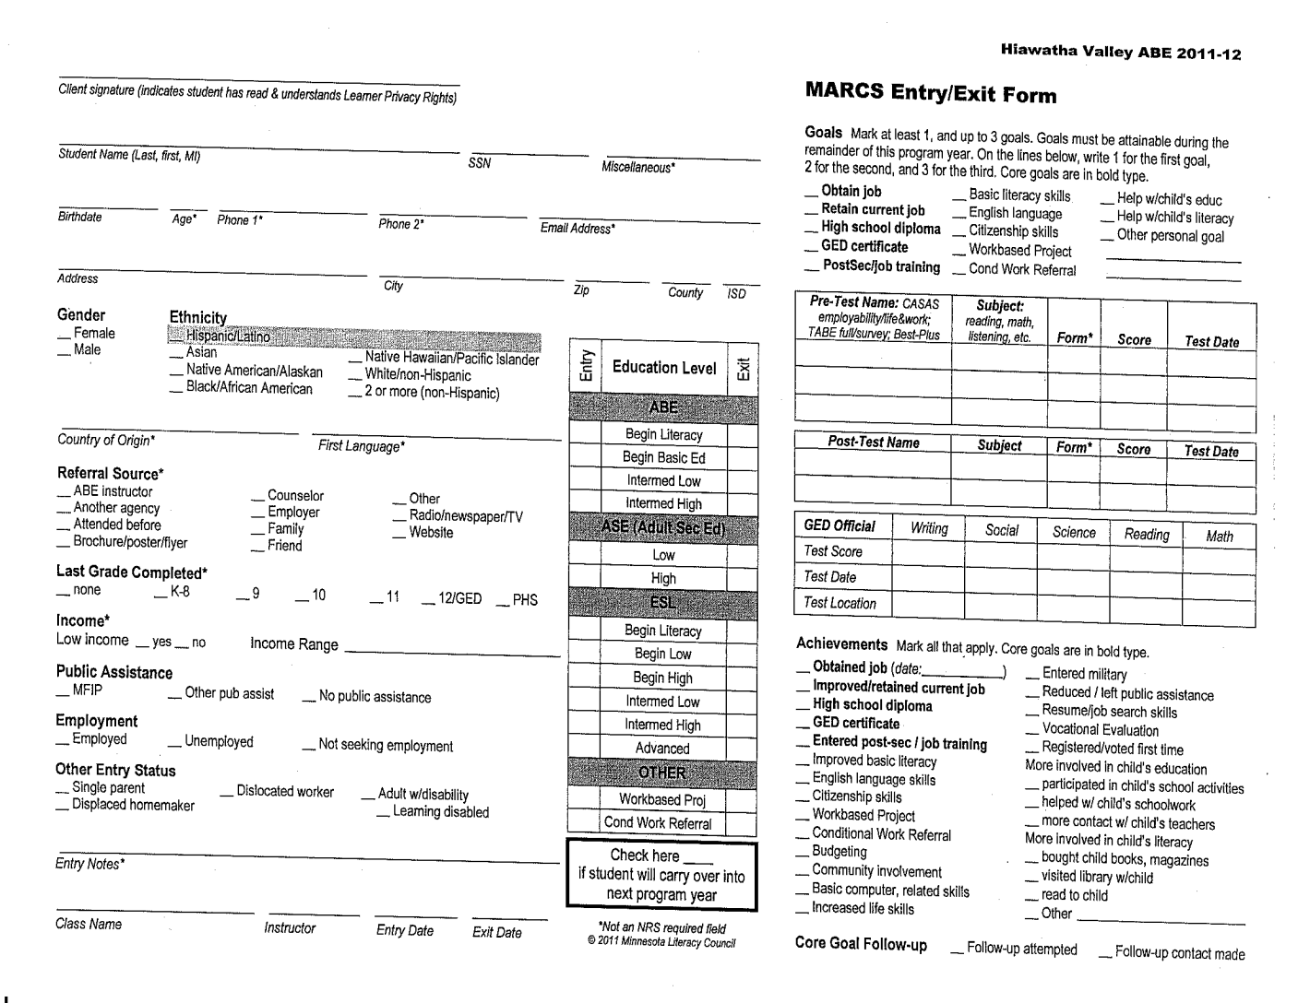
MARCS Entry/Exit Form

Slide 33
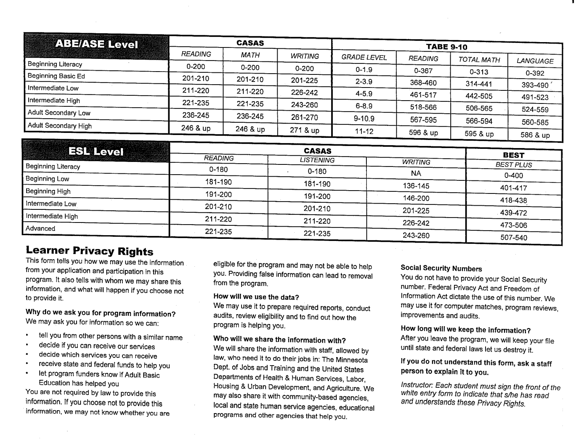
MARCS Entry/Exit Form

Slide 34
Registration Forms
Find the Green HVABE Privacy Rights form:
- This form explains your privacy rights
Find the White Behavior Code form:
- This form explains your rights and responsibilities as an Adult Education student

Slide 35
Your Privacy Rights
Hiawatha Valley Adult Basic Education
Headquarters: Red Wing Community Education
2451 Eagle Ridge Drive, Red Wing, MN 55066
Telephone: (651)385-4562 – MN State Southeast Technical Class Site (651) 385-6348
YOUR PRIVACY RIGHTS
(Tennessen Warning)
We are required by law to ask for your social security number. You do not have to give us one. Social security numbers may be given to the Minnesota Department of Education, the U.S. Department of Education and the Department of Economic Security. These departments use your name and social security number to document learning progress for our annual report. Giving us your social security number is optional, but highly encouraged.
The funding for our program comes from state and federal funds. In order to receive funding, we need to provide information about the learners in our program. This is done through our annual reports. The purpose of this report is to provide accountability for our program. The information you share with us does not go to other government agencies unless you request that we do this.
I have read and understand my Data Privacy Rights.
Learner signature_________________________________________ Date _________________
If you are a mandated learner:
You may be required, or mandated, to attend our classes by an agency or organization. These organizations may include:
Workforce Development
Human Services
Vocational Rehabilitation Services
State and County Employers
Your Employer
If you are a mandated learner we will need to share information with that agency or organization. That information includes your progress and attendance. The Adult Basic Education Program does not determine what is an excused absence. If you have circumstances that prevent you from attending classes, you should discuss them with the agency that requires you to come to the center.
We do provide regular attendance reports to the organization that requires you to be here. It is your responsibility to sign-in when you arrive and when you leave. Under no circumstances will the Adult Basic Education Program staff falsify attendance records.
USE OF PHOTOGRAPHS
I give my permission for the use of photographs of myself to be used by Hiawatha Valley ABE for promotion, education, and marketing purposes. I understand that I am not being paid for the use of the photographs.
Signature ___________________________________________ Date ______________________________

Slide 36
ABE Behavior Code
Hiawatha Valley ABE Program
It is the policy of Hiawatha Valley Adult Basic Education (ABE) Program at Minnesota State Southeast Technical College that all necessary steps will be taken to assure the students and staff that they will find the facilities of the ABE classroom peaceful, comfortable, and a safe place in which to read, study, or work.
THIS CODE OF STUDENT BEHAVIOR IS ADOPTED AND SHALL REMAIN IN FORCE UNTIL MODIFIED BY HIAWATHA VALLEY ABE PROGRAM
Membership in the ABE class is a privilege, not a right. Respect for the rights of others shall prevail at all times.
Disruptive behavior is prohibited, including but not limited to the following:
Physical action or the threat of physical action that could cause injury to students or staff
Physical action or threat of physical action that could cause damage to the classroom, building or immediate surrounding.
Verbal abuse toward students and/or staff.
Obscene language
Extended loud speaking or noise that is disruptive to students and/or staff
Groups of students, seated together, when they are the source of unacceptable noise levels, may be asked to reseat themselves or remove themselves from the classroom.
Lewd or suggestive words or actions to students and/or staff
A pattern of napping or sleeping
Actions suggesting the influence of alcohol, drugs, or other controlled substances
Running and/or rough housing in the classroom or school building
Falsifying entry or exit time on the class attendance sheet.
Student shall not smoke in the school building and are only allowed smoking at designated areas outside the building.
Commission of any offense which would constitute a misdemeanor or felony under the criminal laws of Goodhue County or the State of Minnesota is prohibited.
In the event of a violation of the Code of Behavior, sanctions may be taken in the form of warning, instructions to leave the classroom and/or school building, a call to police, or other legal action as, in each instance, seems most appropriate.
Enrolled students are expected to study in class a minimum of 1 hour for every 2 hours class is in session. Students will record on a form their arrival to the classroom (student log-in book at front of the classroom) and the time they leave the classroom. Students will be able to take breaks as needed. This rule will prevail, unless extenuating circumstances are brought to the attention of the instructor.
I have read and understand the Hiawatha Valley ABE Program Behavior Code.
____________________________________ ______________________
Signature Date

Slide 37
RIGHTS AND RESPONSIBILITIES OF ADULT BASIC EDUCATION STUDENTS
STUDENT RIGHTS:
Free adult education materials, tuition, and instruction
Trained and qualified staff members eager to assist you in meeting your goals
A program of study based on your learning style and designed to meet your needs
No discrimination; no grade; no pressure to “keep up” – work at your own pace
Evaluation for proper placement; input about placement materials
Reasonable accommodations, modifications, or auxiliary services for learning
An environment suitable for learning
Confidential records shared only with the student’s consent
STUDENT RESPONSIBILITIES:
Attend class on a regular basis in order to meet goals in a timely manner. Notify instructor when you need to be absent.
Follow the code of conduct and the terms of your contract/personal education plan.
Take an active part in planning, learning, and tracking progress in your chosen program of study. You will be checking much of your own work. You must stay on task.
Sign in accurately on the sign-in sheet located in the front of the room. When you sign out, you are expected to leave the building.
Respect the rights of other students; be considerate.
Keep the study area clean. Check with instructor about eating areas.
Minnesota State Southeast Technical College buildings, by state law, are smoke-free. The instructor will provide information on smoking regulations.
All materials for student use are free of charge; however, no materials should leave the room without permission. Many materials must be shared with other students so please ask your instructor.
Code of Conduct:
You will be terminated or suspended temporarily from the ABE program for any of the following offenses:
Possession or distribution of stolen property, contraband, fireworks, explosives, firearms, or weapons of any kind.
Disruptive behavior prohibited – refer to list on Program Behavior Code signature form.

Slide 38
Registration Forms
Find the White Computer Survey form:
- This forms help assess your present computer skills
Find the Blue Learning Styles form:
- This form provides an opportunity for you to discuss things that will help you learn better
Or
Complete the VARK learning style inventory online

Slide 39
Registration Forms
Find the White ABE Personal Education Plan form:
- This form will be filled out after you complete your CASAS Assessment
- This form gives you the opportunity to set goal for your learning and also to discuss any special needs you have with your instructor

Slide 40
Complete Forms
“The beautiful thing about learning is that no one can take it away from you.”
B.B. King
Please let your instructor know when you have completed all your forms.

Slide 41
Adult Education Staff
Hiawatha Valley Director of Adult Education ~ 651.385.4562
Hiawatha Valley Adult Education Intake Counselor ~ 651.385.4774
SE Tech Classroom~ 651.385.6348

Slide 42
Review
Choose ABE Traditional or Online Class
Attendance = Learning
Commit to a schedule with your instructor
You have to commit to attend class to learn
Testing = What you know
So we can see what you need to learn
Improve / Do your best / Learn
Set the goals you want to acheive

