Slide 1
Fall Kickoff Meeting
Data and Reporting

Slide 2
Data and Reporting for DL
Creating classes
Enrolling students
Face to Face hours
Data you will want to keep your eye on throughout the year

Slide 3
Setting up DL classes in SID (Proxy Hours)
Class Name is no longer required to include name of the DL curriculum and the word "proxy." However, we recommend you continue to use them to easily identify DL proxy classes.
Attendance Format - to enter proxy hours in chunks/blocks of time*, select "lab" (rather than "scheduled" time). This will allow you to type in a number of hours earned when entering attendance.
Student Hour Type must say Distance Learning. (Only proxy hours should be marked with an Hour Type of distance learning. Do not mark this type for student/teacher contact hours.)
Distance Learning Program - select the name of the DL curriculum from the menu.
https://mnabe.zendesk.com/hc/en-us/articles/228092687-Create-a-distance-larning-proxy-class

Slide 4
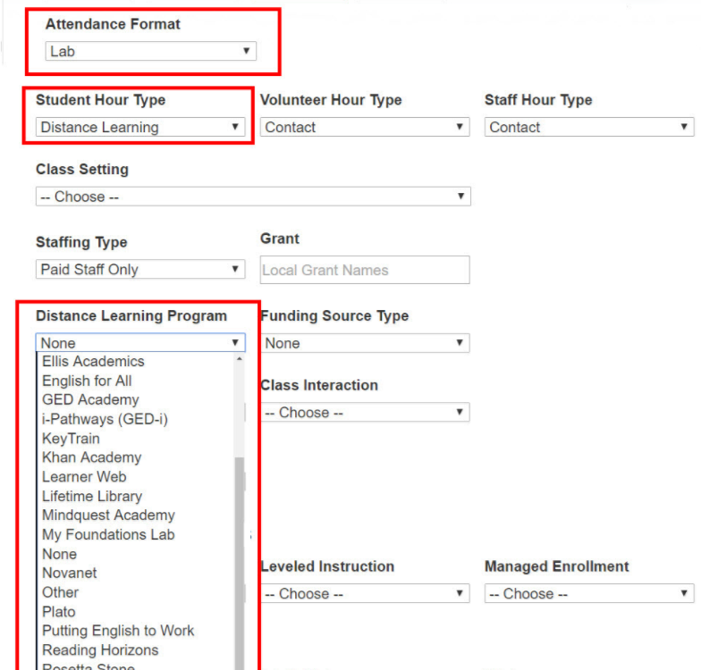
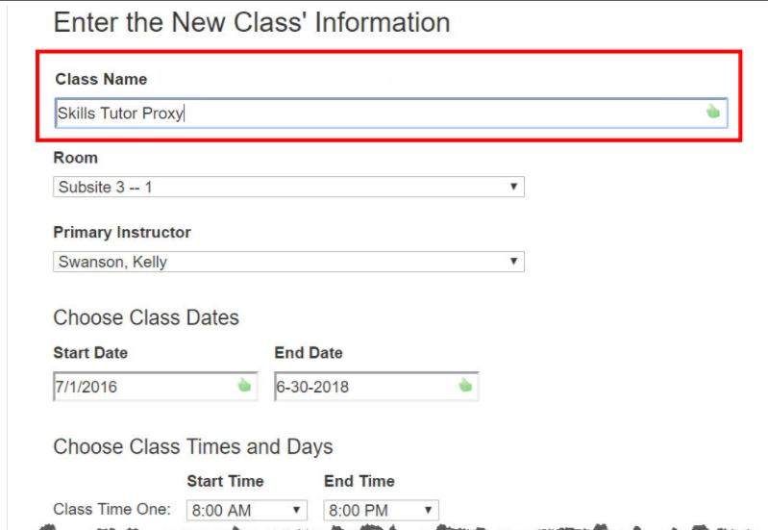
Setting up DL classes in SID: Class Creation Screen
Notes:
Jenny - generally

Slide 5
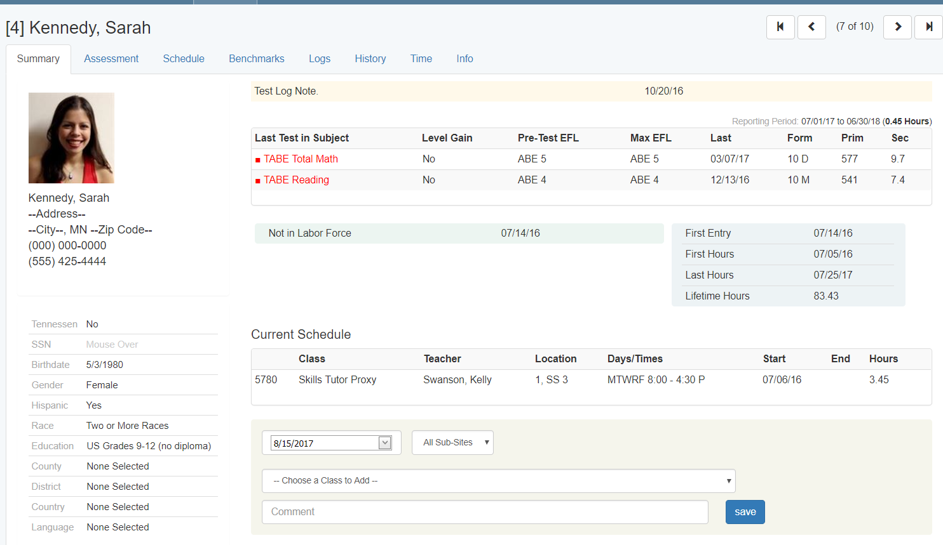
Enrolling students in DL classes
From Student’s Page:
Notes:
Jenny – generally
Jess & Adam (best practices, i.e. not enrolling in more than 1 DL class at a time, or exceptions to that with 1-2 examples, such as students enrolled in hybrid class)

Slide 6
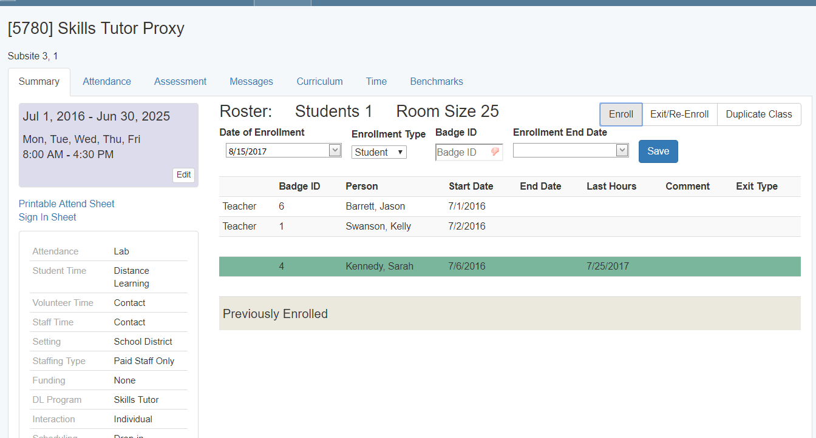
Enrolling students in DL classes
From Class page - enroll many student quickly:

Slide 7
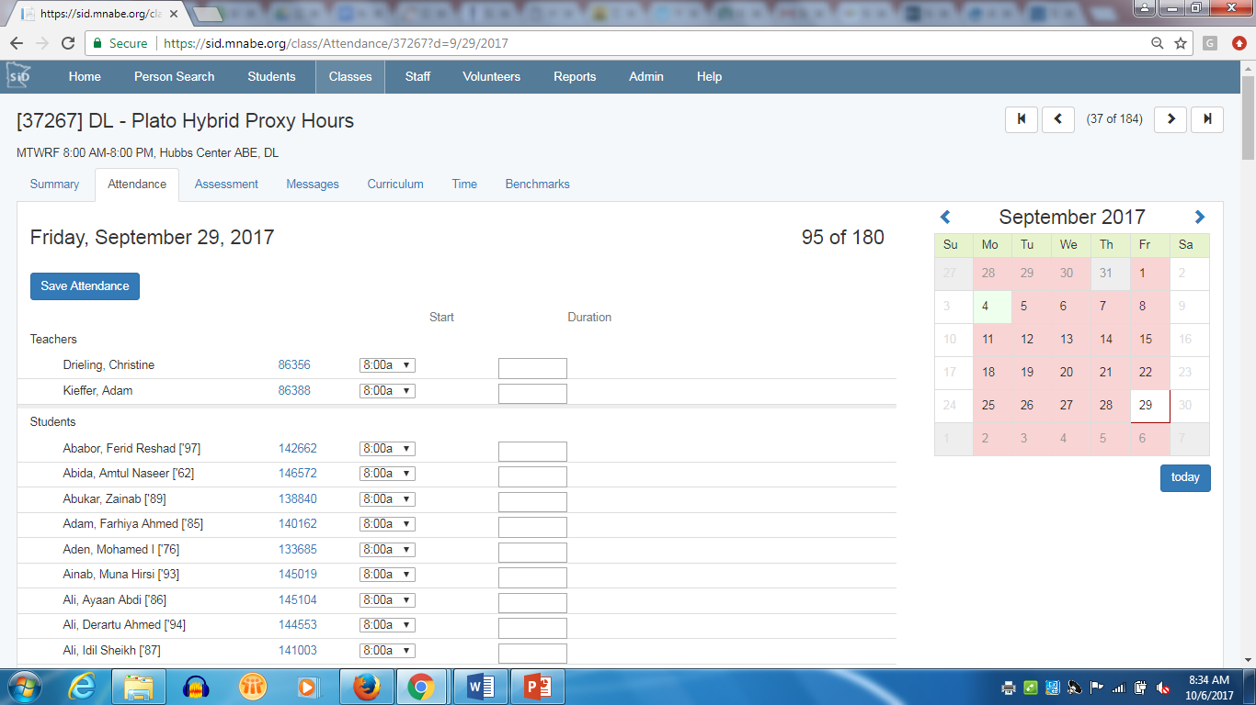
Giving Attendance

Slide 8
DL (F2F) Time
Screencast (with audio): https://www.screencast.com/t/R68jet0x1y
Notes:
Adam -

Slide 9
Possible Issues
DL proxy hours can overlap with class hours, but face to face can’t
You can use a non-reportable class to track F2F time in SID

Slide 10
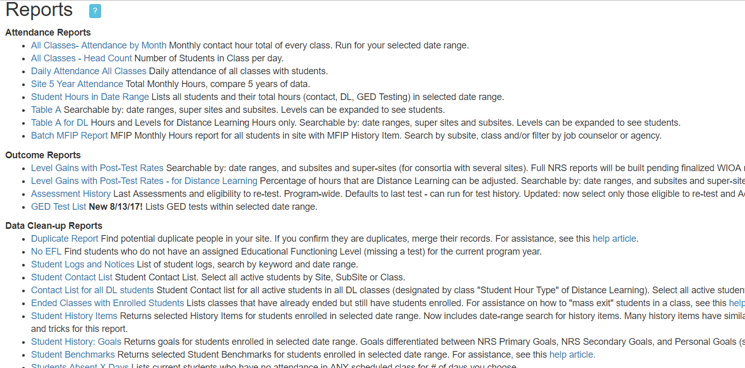
DL reports
Notes:
DL (Jenny- general overview); Level Gains with Post-Test Rates - for Distance Learning (how relevant for DL staff? -Jenny -general overview);

Slide 11
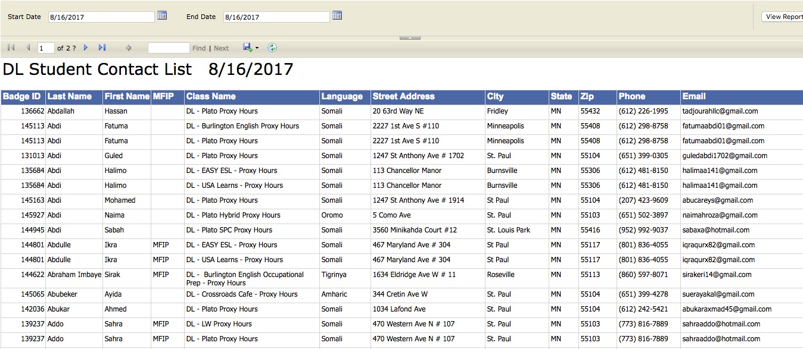
Contact List for all DL students - How to
Email all students, sort by MFIP status, eliminate duplicate emails (in Excel)
Screencast (with audio): https://screencast-o-matic.com/watch/cbjDo5lKA2
Notes:
Jess - Contact List for al DL students (email lists: all, students in a specific DL class, MFIPers only) Show how to Download in Excel, then sort (handouts with screenshots or links to screencasts or collect emails from participants)

Slide 12
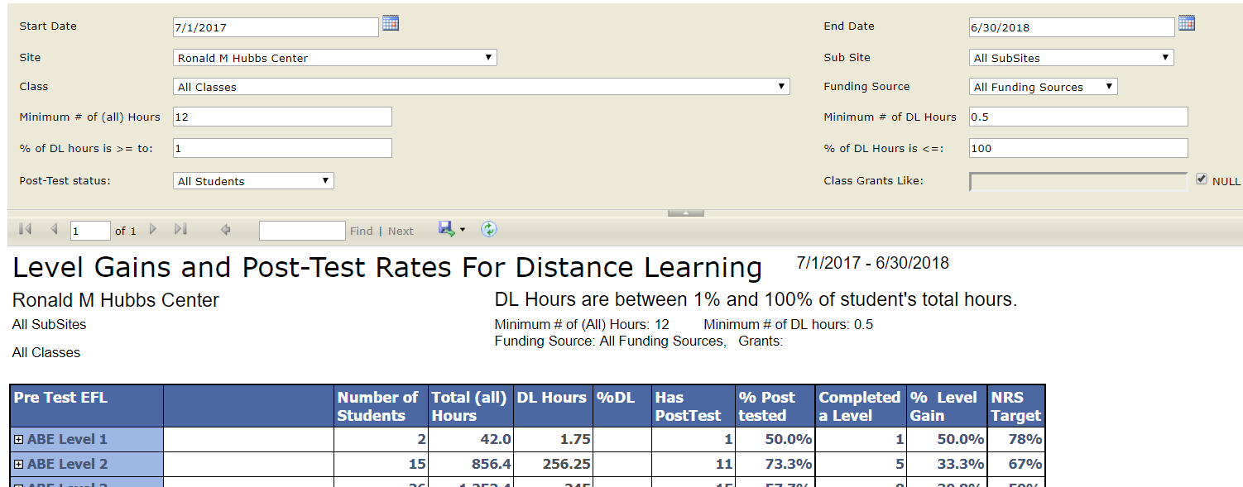

Slide 13
Using Logs to track other DL data
Log Types:
Notice: Shows up on the student Summary tab (home screen); only staff can see it
Private: Only staff can see it by clicking on Logs tab (Most used by DL staff)
Public: All programs that share the student can see it in the Logs tab
Notes:
Jess and Adam -with examples; Define, screenshots or live for examples with ID#s ready to go

Slide 14
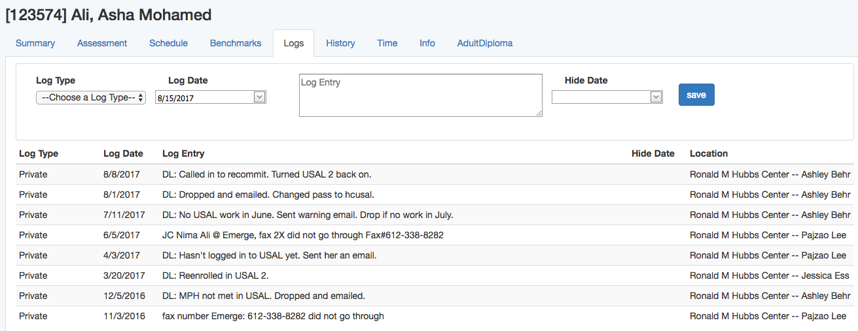
Using Logs: Examples
Notes:
Jess - insert screenshots or links here?

Slide 15
Things to track during the year
Review monthly
How many students enrolled in your DL class -vs- how many students active in the class
Are you growing?
Concerns about level of activity?
Which platforms are getting usage?

Slide 16
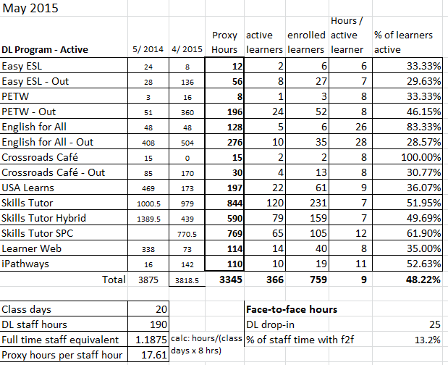
Example – Monthly report

Slide 17
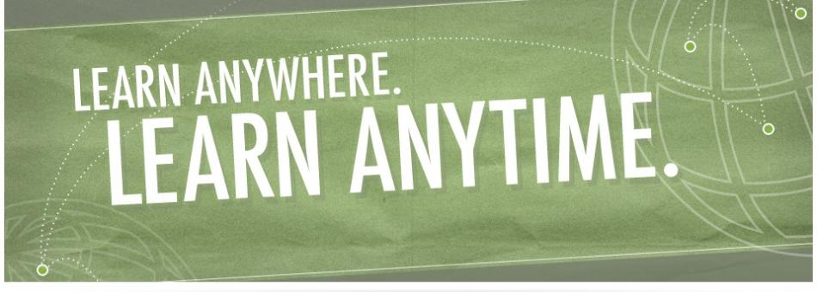
Questions?

