Slide 1
How to Be a Digital Navigator
Literacy Minnesota
Notes:
Eric talk about his path to literacy.

Slide 2
Agenda
Welcome
Digital Equity
Digital Navigation Overview
Digital Navigation and the Eight Componenets
Digital Navigation Best Practices
Northstar Digital Literacy
I

Slide 3
Who We Are
A non-profit leader and a driving force behind the latest developments in literacy learning.
Extensive experience with Adult Basic Education including English Language Learning and High School Equivalency
Nationally recognized for advocacy, best practices, and educational materials
https://www.literacymn.org
I

Slide 4
The Digital Divide
24% of adults in the US lack basic digital literacy skills
How does this affect them?
How has COVID-19 exacerbated the gap?

Slide 5
Digital Equity
Devices
Access
Skills
Notes:
Tom - Access – connectivity to the Internet (broadband; Devices – hardware to use in accessing the Internet (smart phone, tablet, computer); Skills – support and training in how to use devices and the Internet

Slide 6
Being a Digital Navigator
You do not need to have an advanced degree to be a digital navigator
A little bit of basic knowledge and the willingness to learn on the fly.
The eight components and other resources in this presentation and on the sheet will be beneficial when providing digital navigation to Adult Education programs and learners.
Helpful to understand each of the eight components as they will be a majority of how you could provide digital navigation to a learner.
Notes:
Theresa

Slide 7
Eight Components of Digital Navigation
Assess student and program needs
Devices for learners
Internet for learners
Configuring devices for learners
Provide initial training on software and devices
Provide ongoing digital literacy skill training
Provide tech support
Wrap around navigation support.
Notes:
Theresa

Slide 8
Possible Digital Navigator Roles
Set up devices
Provide initial training for clients
Ongoing training / check-ins
Digital literacy and life goal setting
Tech support assistance
Basic digital literacy instruction
Others?
Notes:
Theresa

Slide 9
Assessing Program and Student Needs
Help programs determine their need for digital navigation.
Help programs assess student needs.
Provide resources
Add photo
Notes:
Theresa

Slide 10
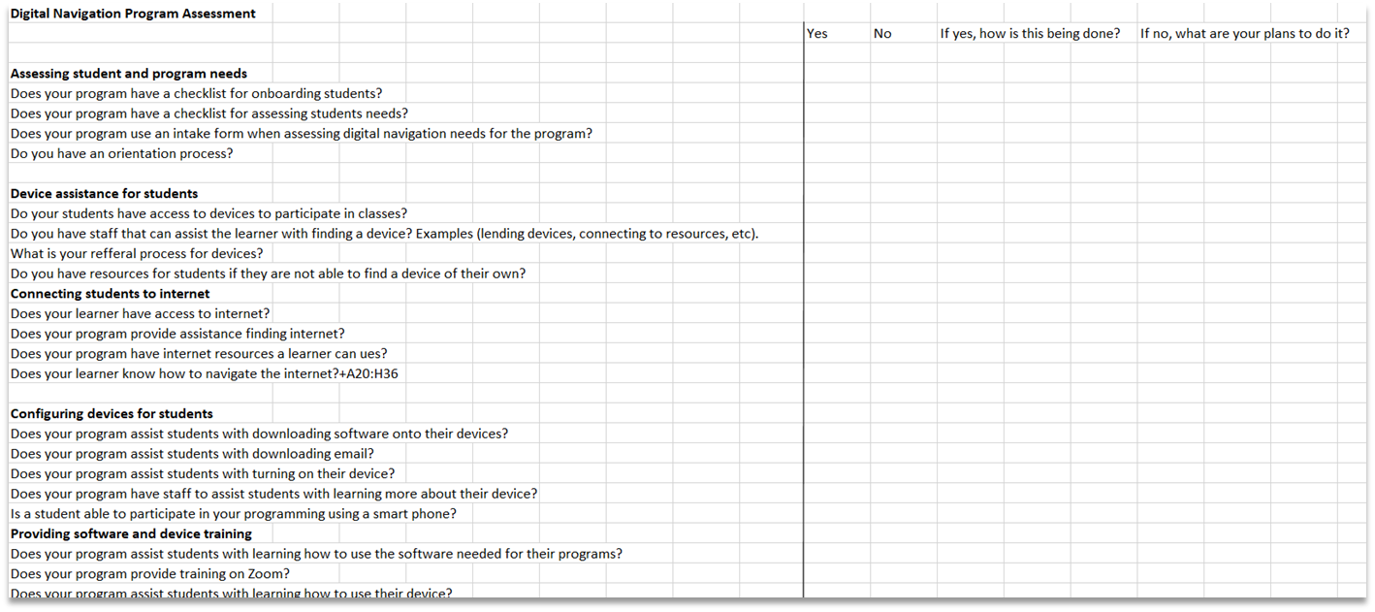
Literacy Minnesota Program Assessment
Notes:
Theresa

Slide 11
Open Door Learning Center
Open door learning center created a needs assessment to use with students during the intake process.
Very basic needs for students
Great example of a way to assess student needs during intake.
Able to work directly with the student to learn what they need.
Can they start on-line class via a phone? iPhone or Android?
Do you have WhatsApp on the phone?-- followed by downloading + practice
Do you have Zoom on the phone? -- followed by downloading + practice
Do you have wifi at home?
Do you have a desktop or laptop? If yes, we install WhatsApp & Zoom. If no, I submit them for a device
Notes:
Theresa

Slide 12
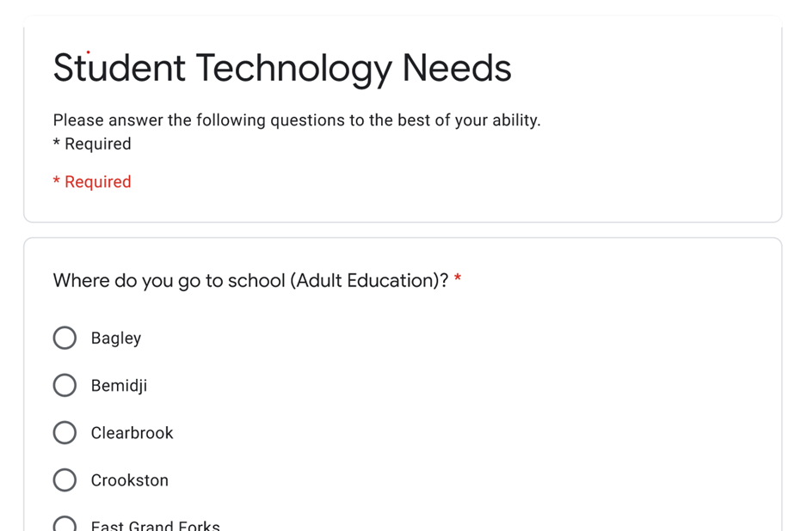
Northwest Services Cooperative
Created a survey for a cohort to gather information.
How to determine what skills a student needs assistance with.
Great way to receive more answers to help you decide your need for digital navigation.
Notes:
Theresa

Slide 13
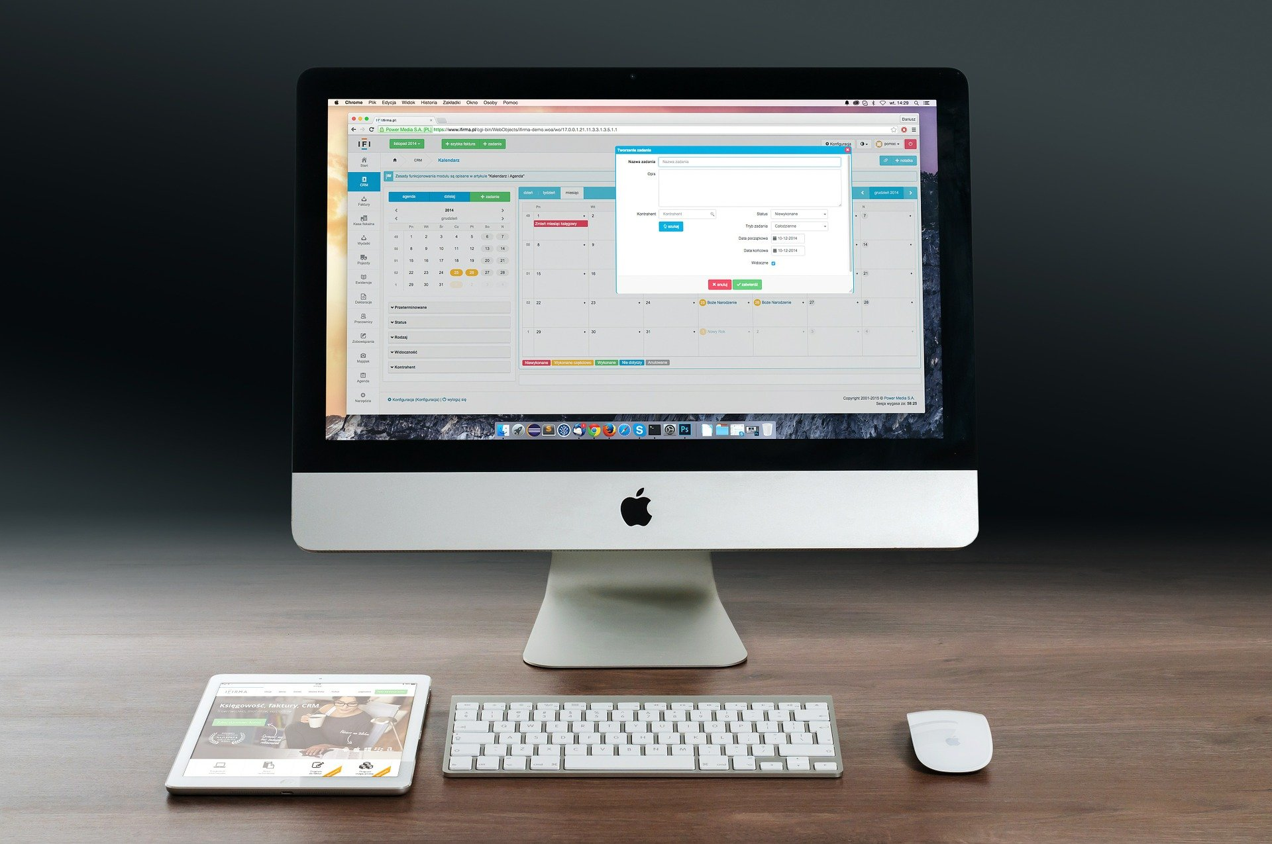
Access to Devices
Onsite computer labs
Lending devices
Giving devices
Connecting to outside organizations
Notes:
Theresa

Slide 14
Access to Internet
For some learners internet access is important and for others it is not an issue.
Very few programs provided wifi for their learners
Accessing public wifi
Hotspot lending programs
Low-cost or subsidized wifi programs
Notes:
Theresa

Slide 15
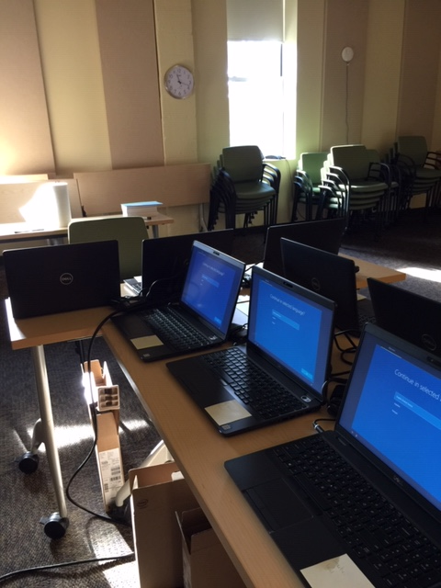
Configuring Software and Devices
“Out of Box Experience”
Configure Hotspots/WiFi
Update Systems Software
Download Program Software
Bookmark Relevant Pages
Notes:
Theresa

Slide 16
Initial Training for Learners
Base it on how they will be using the computer for the program or in their day-to-day lives
Basic Device Use
Turning it on
Charging
How to connect to WiFi
Password Management
Notes:
Theresa

Slide 17
Initial Training for Learners
Opening a browser
Software
Email
Zoom
Program-related software
Practice any program for real-life tasks
Notes:
Theresa

Slide 18
On-going Digital Navigation
Regular check-ins
Problem-solving check-ins
Further digital literacy instruction
Northstar digital literacy curriculum
Digital literacy classes
Digital push-in classes
One-to-one tutoring
On demand support
Notes:
Theresa

Slide 19
Navigating Tech Support
Understand how the organization will handle learners with tech issues
Learn what the tech support policy/process is
Consider providing an initial level of in-house tech support to the learner
Is it a tech issue or is it user error?
Naming the problem?
How can client communicate the issue to tech support vendor?
Notes:
Theresa

Slide 20
Navigating Tech Support
“Hi, my name is ____________.”
“I received a laptop from the ____________ program.”
“The identification number for the laptop is _______.”
“I have been working with a navigator and we think the problem is _____________.”
“What do I need to do to get this fixed?”
Notes:
Theresa

Slide 21
Wrap-Around Navigation
Does the program provide wrap around navigation services?
Where can I make a referral when possible?
Social services, job assistance, child care.

Slide 22
Tips for Remote Navigation
Go step-by-step
Check in about communication
Check understanding each step of the way “What do you see on the screen?” “What just happened on your computer?”
Practice describing

Slide 23
Digital Navigation Resources
Digital US
NDIA
Our own website
PC’s for People/Tech Dump
Saint Paul Public Libraries
Northstar Digital Assessments
Literacy Minnesota Resource Page
Notes:
Theresa

Slide 24
Contact Information
Name – Program and Title
Name@email.com
Notes:
Theresa

