Slide 1
Eight Components of Digital Navigation
Notes:
Refer to welcome letter.
Eric talk about his path to literacy.

Slide 2
Agenda
Welcome
Objective
Digital Equity
Digital Navigation vs. Digital Navigator
Eight Components of Digital Navigation
Wrap Up
Notes:
Refer to welcome letter.
Eric talk about his path to literacy.

Slide 3
Objective
At the end of this presentation you will have a better understanding of the eight components of digital navigation.
You will also have ideas of how to integrate digital navigation into your program.
Notes:
Refer to welcome letter.
Eric talk about his path to literacy.

Slide 4
Digital Navigator vs Digital Navigation
Digital Navigation is providing assistance with digital literacy skills, access to devices and ongoing digital support.
Digital Navigators are staff or volunteers that provide digital navigation assistance to programs or learners.
Notes:
Refer to welcome letter.
Eric talk about his path to literacy.

Slide 5
Digital Equity
Devices
Access
Skills
Notes:
Refer to welcome letter.
Eric talk about his path to literacy.

Slide 6
The Eight Components of Digital Navigation?
Assessing student and program needs
Providing access to devices
Providing access to internet
Configuring devices
Providing initial training on software and devices
Providing ongoing digital literacy skill training
Providing ongoing tech support
Providing wrap around navigation support
Notes:
Refer to welcome letter.
Eric talk about his path to literacy.

Slide 7
Component # 1: Assessing Student and Program Needs.
There are two parts: assessing student needs and assessing program capacity.
Assessing needs of students and programs is crucial in understanding what digital navigation services you provide or would like to provide.
Notes:
Refer to welcome letter.
Eric talk about his path to literacy.

Slide 8
Assessing Student Needs
The goal is to determine what digital literacy barriers prevent learners from participating in your program.
Questions might include: Do you have a device? Do you have access to internet? Etc.
Create a survey/ assessment of your own or use one of these.
Northwest Services Cooperative.
Open Door Learning Center.
Notes:
Refer to welcome letter.
Eric talk about his path to literacy.

Slide 9
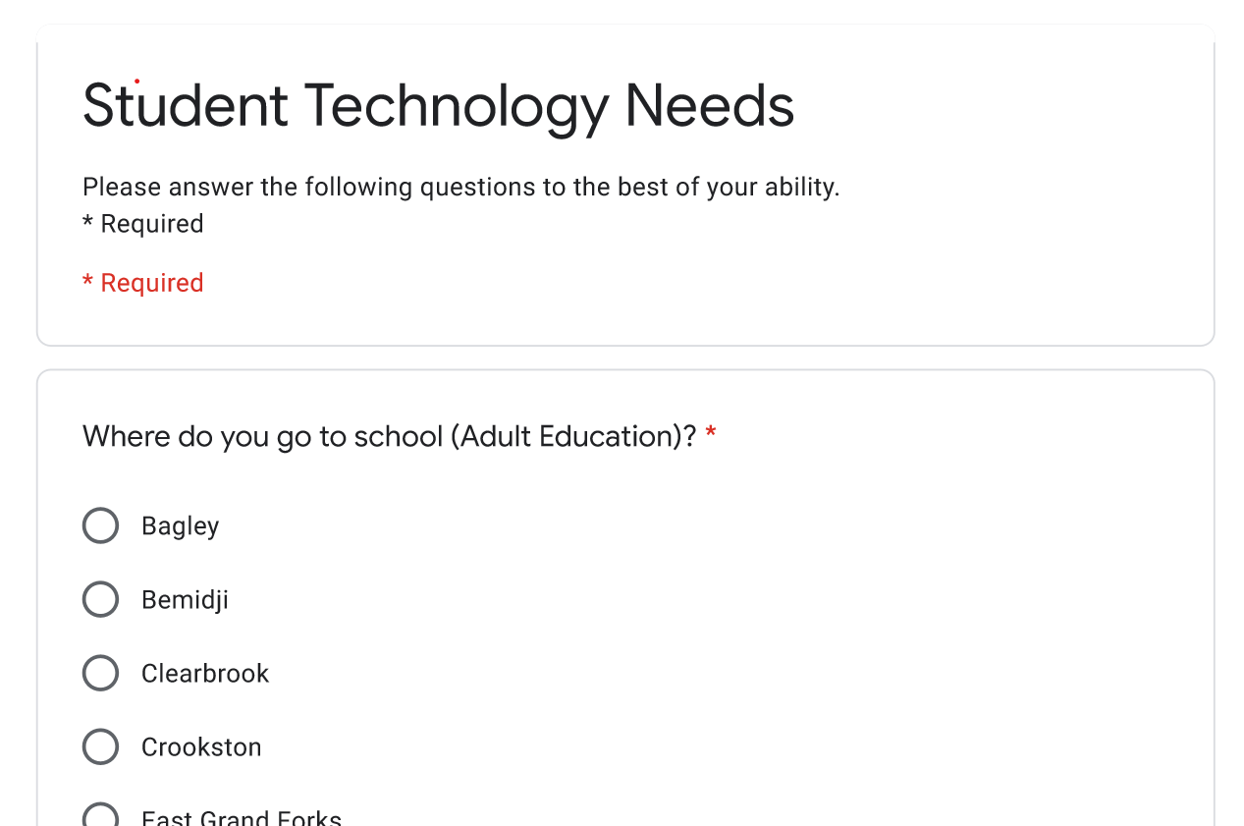
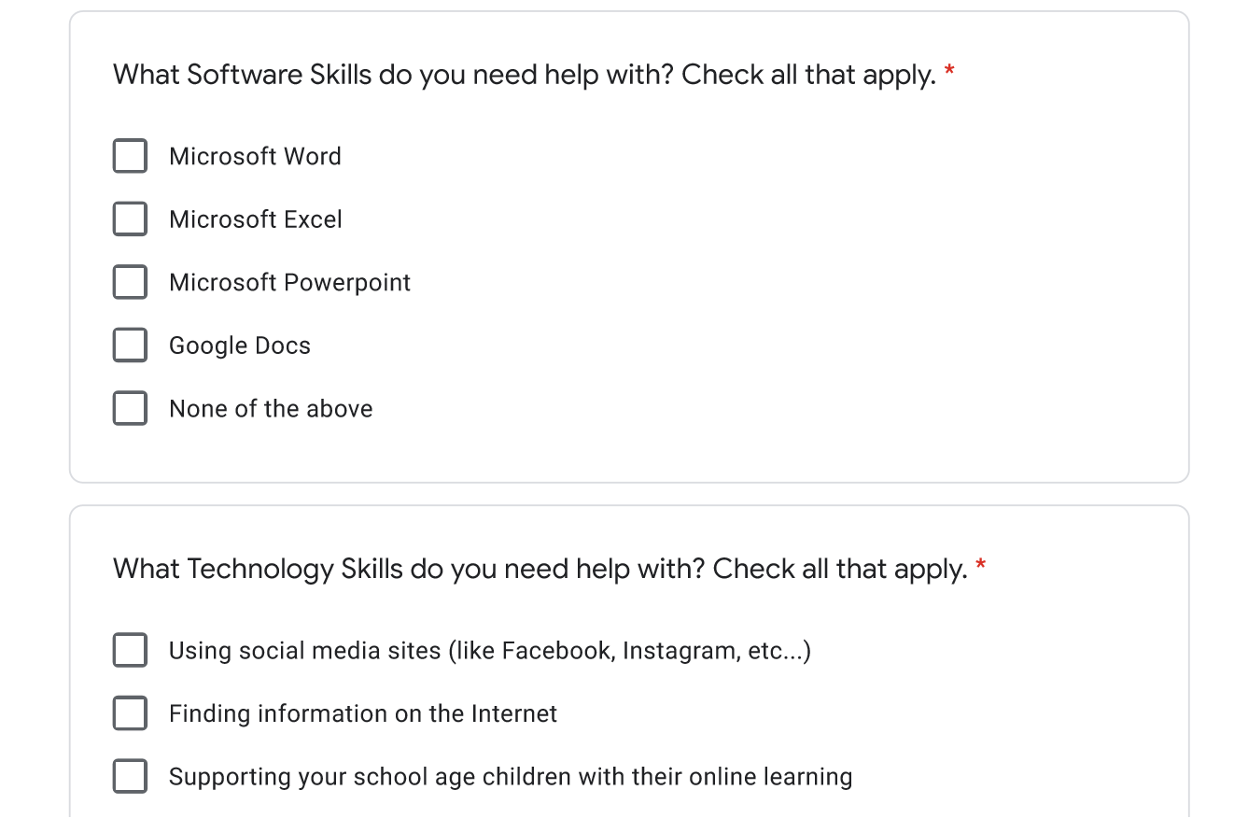
Northwest Services COOP
Notes:
Refer to welcome letter.
Eric talk about his path to literacy.

Slide 10
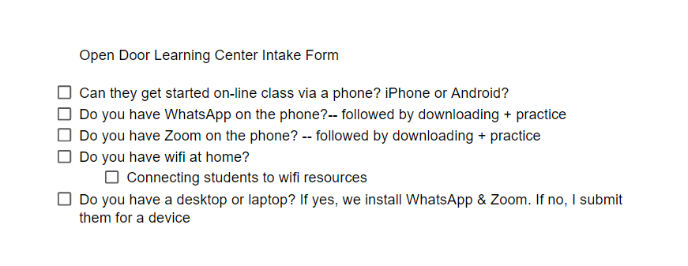
Literacy Minnesota student assessments
Notes:
Refer to welcome letter.
Eric talk about his path to literacy.

Slide 11
Notes on assessing your program needs
Assessing program needs helps determine where the program is needing digital navigation support provided by staff or hired on digital navigators.
Assessing all parts of the program to determine what is ans is not provided.
Literacy Minnesota created a generic intake form.
Notes:
Refer to welcome letter.
Eric talk about his path to literacy.

Slide 12
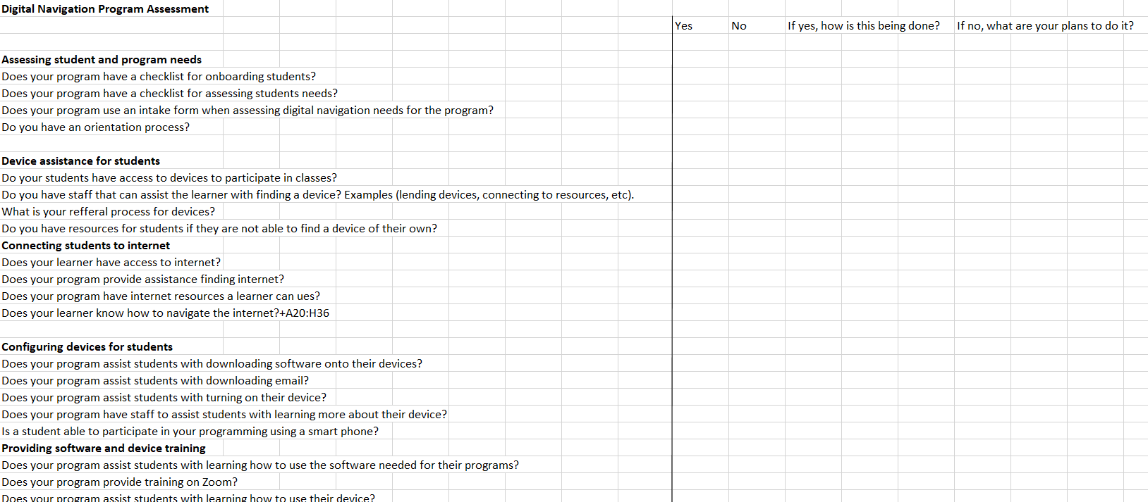
Literacy Minnesota Intake Form
Notes:
Refer to welcome letter.
Eric talk about his path to literacy.

Slide 13
Component #2: Accessing Devices for Learners
Learners often need devices to participate in their programming
Onsite computer labs
Lending devices
Giving devices
Connecting to outside organizations
Providing staff/volunteers to assist students with finding a device.
Notes:
Refer to welcome letter.
Eric talk about his path to literacy.

Slide 14
Component #3: Accessing Internet for learners
For some learners internet access was important and for others it was not an issue.
Very few programs provided wifi for their learners
Accessing public wifi
Hotspot lending programs
Low-cost or subsidized wifi programs
Notes:
Refer to welcome letter.
Eric talk about his path to literacy.

Slide 15
Component #4: Configuring Devices and Software
Assisting with uploading software needed for learners to participate in distance learning.
Ensuring that the software and devices are up to date.
Running through set up of devices.
Create account to use their device.
Some programs have dedicated staff to assist with this.
Some programs use classroom teachers to assist with this.
Notes:
Refer to welcome letter.
Eric talk about his path to literacy.

Slide 16
Component #5: Initial Training for Students.
Base this on how the student will be using the device for your program.
Basic device use
Turning it on
Charging
Connecting to Wifi
Password Management
Opening a Browser
Basic software use: Email, Zoom, program related software.
Notes:
Refer to welcome letter.
Eric talk about his path to literacy.

Slide 17
Component #6: Provide Ongoing Digital Navigation Skill Training
Providing ongoing digital is important for encouraging digital skill learning.
Northstar digital literacy curriculum
Other ongoing computer skill learning.
Digital literacy classes.
Digital push-in classes.
One-to-one tutoring.
On demand support.
Notes:
Refer to welcome letter.
Eric talk about his path to literacy.

Slide 18
Component #7: Ongoing Tech Support
Bigger issues than programs expected it would be.
Develop a plan for how your organization will handle learners with tech issues.
Learn what the vendor tech support policy/process is.
Consider providing an initial level of in-house tech support.
Is this a tech issue or user error?
Help learners name the problem
How can a student convey the tech issue to a vendor?
Notes:
Refer to welcome letter.
Eric talk about his path to literacy.

Slide 19
Component #8: Wrap Around Navigation
Many programs have in-house navigation services.
Connecting learners to other resources for needs outside of the classroom.
Job searching assistance
Housing assistance
Childcare
Notes:
Refer to welcome letter.
Eric talk about his path to literacy.

Slide 20
How Do You See the Eight Components Working in Your Program?
Needs assessments of what your program would need assistance with.
What is your program already doing?
What are your next steps for filling in any gaps?
Notes:
Refer to welcome letter.
Eric talk about his path to literacy.

Slide 21
Questions?
Notes:
Refer to welcome letter.
Eric talk about his path to literacy.

