Slide 1
`
Formatting | Writing Process | Documents | Keyboard | Miscellaneous
10 | 10 | 10 | 10 | 10
20 | 20 | 20 | 20 | 20
30 | 30 | 30 | 30 | 30
50 | 50 | 50 | 50 | 50
100 | 100 | Blank | 100 | 100
2000 | 2000 | 2000 | 2000 | 2000

Slide 2
The tool from the ribbon that makes text look like this:
ABCD
(instead of ABCD)

Slide 3
BOLD

Slide 4
The tool that makes text look like this: abcde

Slide 5
Underline

Slide 6
This is what you use if you want to remove text from where it is and paste it somewhere else.

Slide 7
Cut

Slide 8
The name for different kinds of text (the tool you use to change the way text looks)

Slide 9
Font

Slide 10
This is the tool we use to see if all of the words in our writing are spelled correctly.

Slide 11
Spell Check

Slide 12
What are the two options for page orientation?

Slide 13
Portrait and Landscape

Slide 14
This is how many steps there are in the writing process.

Slide 15
Five

Slide 16
This step involves including peers to check spelling and make sure all sentences are complete.

Slide 17
Editing

Slide 18
This step involves ensuring that details are in an appropriate order and the details are expanded into sentences.

Slide 19
Drafting

Slide 20
This step would include sending a cover letter to an employer.

Slide 21
Publishing (or Sharing)

Slide 22
This step includes making sure the details in a document are clear.

Slide 23
Revising

Slide 24
List at least 2 of of the 3 tasks that are accomplished in the Prewriting step.

Slide 25
1. Narrowing down your topic (brainstorming)
2. Identifying your audience
3. Picking details

Slide 26
This is the program we have been working on in class.

Slide 27
Microsoft Word

Slide 28
This is the document you attach to a resume.

Slide 29
Cover Letter

Slide 30
This document lists relevant work experience as well as education and military experience.

Slide 31
Resume

Slide 32
These are the steps to save a new document.

Slide 33
1. Click file
2. Click Save As
3. Find the location you wish to save it to
4. Name it
5. Click save

Slide 36
This is the extension added to the end of a Word 2010 document’s name when you save it.

Slide 37
.docx

Slide 38
This key places a space between two characters.

Slide 39
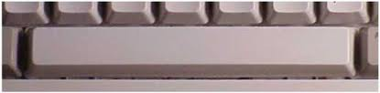
Space key

Slide 40
This key makes all of the letters you type capital letters until you press it again.

Slide 41
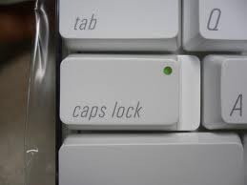
Caps Lock

Slide 42
These keys move the cursor up and down and side to side.

Slide 43
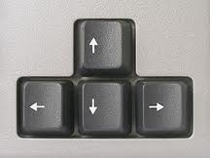
Arrow keys

Slide 44
This key erases text to the right of the cursor.

Slide 45

Delete

Slide 46
This key erased text to the left of the cursor.

Slide 47
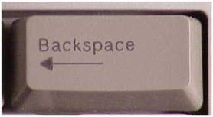
Backspace

Slide 48
This is the shortcut on the keyboard to copy text.

Slide 49

Ctrl+C

Slide 50
This is the type of computer we have been working with in this class. (One of the two types we learned on the first day)

Slide 51
Laptop

Slide 52
The organization that houses this class.

Slide 53

Minnesota Literacy Council

Slide 54
What are the names of your teachers?

Slide 55
You should know this.

Slide 56
What was the first computer mouse made out of?

Slide 57
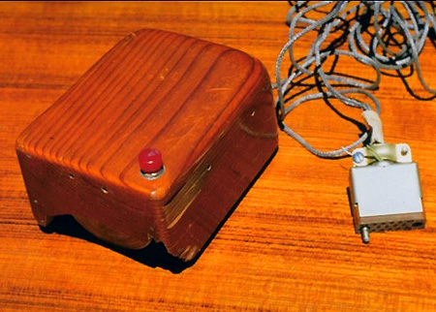
Wood

Slide 58
On average, the human eye blinks 20 times per minute. How many times does a computer user blink per minute?
A. 16 B. 7 C. 12

Slide 59

B. 7

Slide 60
What is the name of the next Computers and Literacy Class?

Slide 61

Reading and Writing for Job Search

