Slide 1
Westward Expansion: 1807-1912
Indian Removal Act, Trail of Tears, and Manifest Destiny

Slide 2
The Indian Removal Act was signed into law by Andrew Jackson on May 28, 1830, authorizing the president to grant unsettled lands west of the Mississippi in exchange for Indian lands within existing state borders.

Slide 3
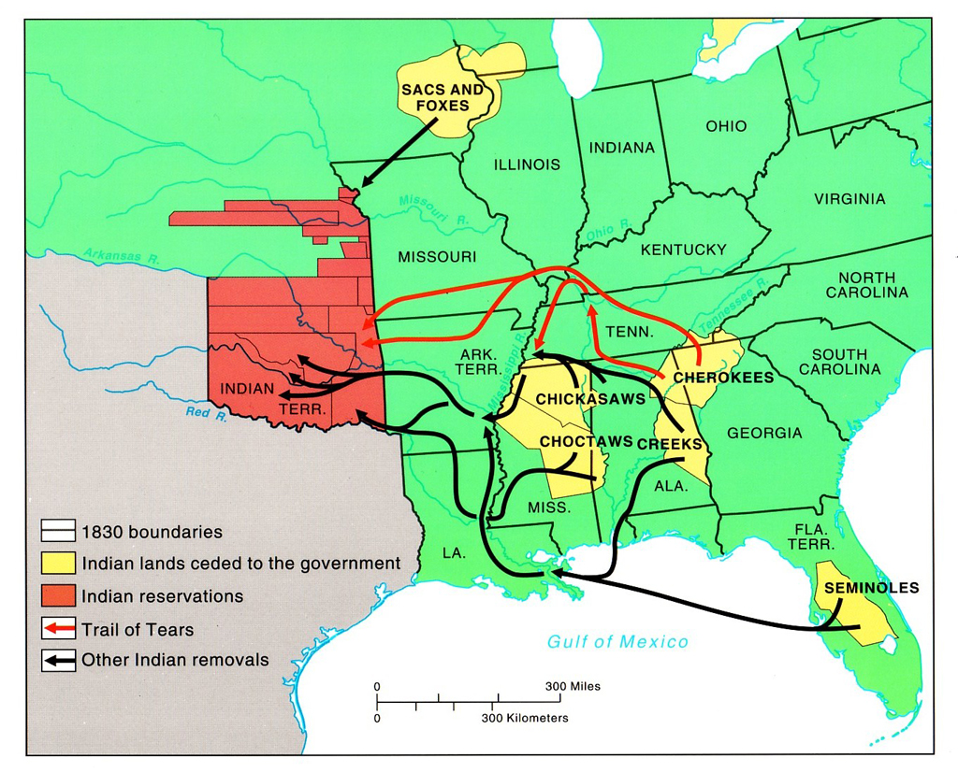

Slide 4
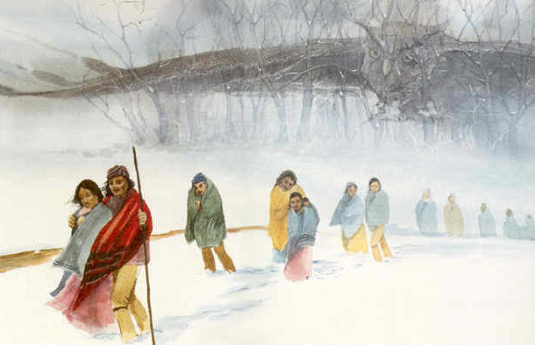
During the fall and winter of 1838 and 1839, the Cherokees were forcibly moved west by the United States government. Approximately 4,000 Cherokees died on this forced march, which became known as the "Trail of Tears."

Slide 5
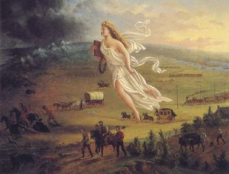
Manifest Destiny was the 19th century American belief that the United States was destined to expand across the continent.

Slide 6
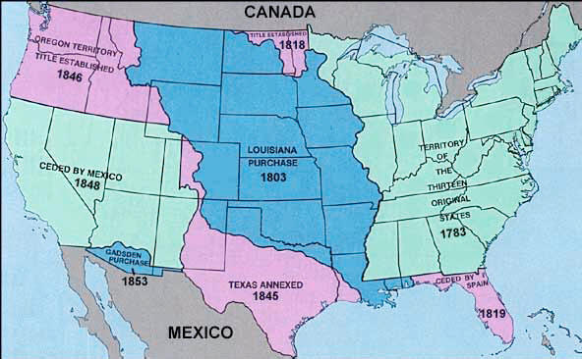
Westward Expansion

Slide 7
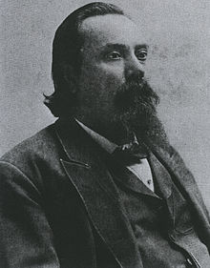
George W. Harkins
George W. Harkins
George Washington Harkins
Born | 1810 Choctaw Nation (Mississippi)
Died | 1861 Ft Towson, Choctaw Nation (Oklahoma)
Residence | Pre-removal: Choctaw Nation (Mississippi): Post-removal: Choctaw Nation in Indian Territory (Oklahoma)
Nationality | Choctaw
Education | Cumberland University, Law
Occupation | Statesman, Tribal chief
Predecessor | Greenwood LeFlore

Slide 8
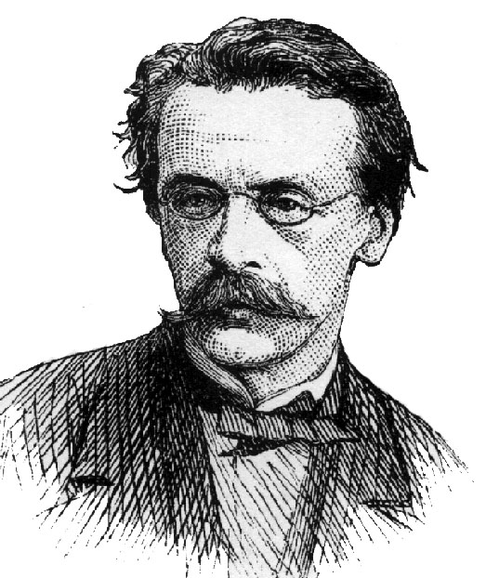
John Louis O'Sullivan (November 15, 1813 – March 24, 1895) was an American columnist and editor who used the term "Manifest Destiny" in 1845 to promote the annexation of Texas and the Oregon Country to the United States. O'Sullivan was an influential political writer and advocate for the Democratic Party at that time, but he faded from prominence soon thereafter. He was rescued from obscurity in the twentieth century after the famous phrase "Manifest Destiny" was traced back to him.

Slide 9
http://www.youtube.com/watch?v=Qrjg9ulR-xo&feature=related

