Slide 1
Resumes: Basic Content Introduction

Slide 2
What is a Resume?
What is the purpose of a Resume?
What information is included in a Resume?
Notes:
Click through these questions and discuss as a group.

Slide 3
Purpose:
The purpose of a resume is to provide a summary of your skills, abilities and accomplishments. It is a quick advertisement of who you are.

Slide 4
Resumes Include:
Your name, address, phone number and email address
Summary-we will explain this more in depth in a few slides
Job history and job responsibilities- we will discuss this more tomorrow
Education
Other information
Notes:
Other information includes any time spent in the military, success in sports or clubs (if related to the job), any hobbies related to the job and any volunteer work

Slide 5
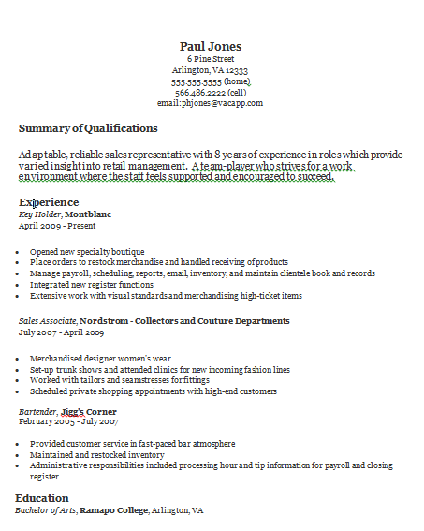
Example Resume

Slide 6
Rules:
No more than one page
Try to fill up that page and avoid white space
Utilize formatting tools to help organize and emphasize
Be consistant with formatting tools
Put most relevant skills and jobs as close to the top of the page as you can

Slide 7
What is the goal of a resume?
An interview!

Slide 8
Body of a Resume
Who are you?
Name, Address,
Phone Number,
Email
f
Summary of Qualifications
Previous Experience
Former Positions
Name of Company
Job Responsibilities
Education
Hobbies, Clubs, etc.

Slide 9
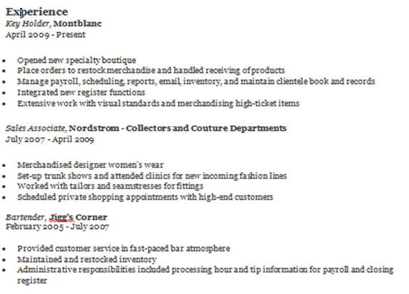
Today we will focus on the Employment History Section

Slide 10
Previous Experience:
Pick most relevant
List at least 3 jobs, if possible
Keep short and to the point
Use action verbs

Slide 11
What are Job Responsibilities?
This will be our focus for the rest of the day, but first, we will review an example resume.

