Slide 1
Main Idea Practice

Slide 2
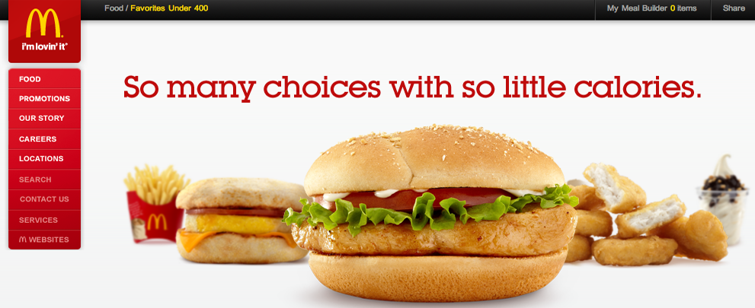
McDonalds

Slide 3
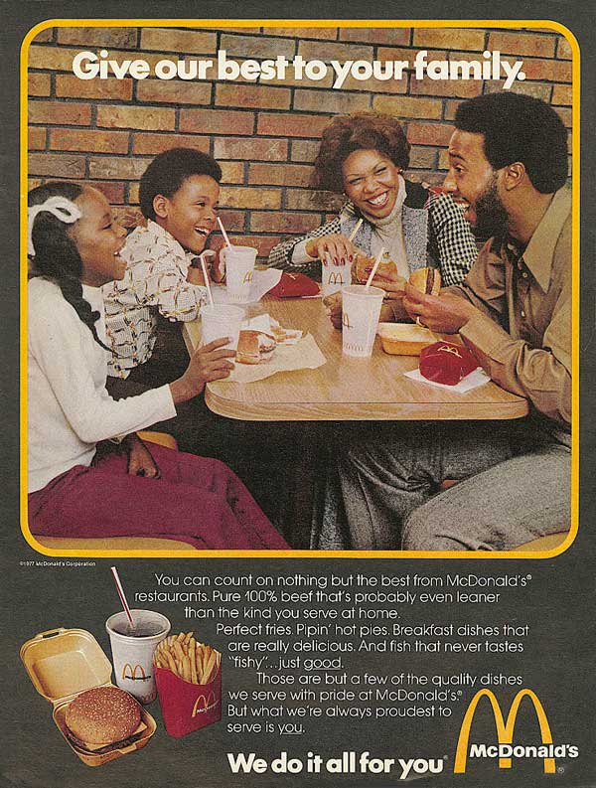
McDonalds

Slide 4
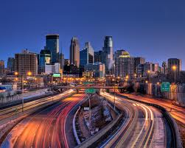
Minneapolis

Slide 5
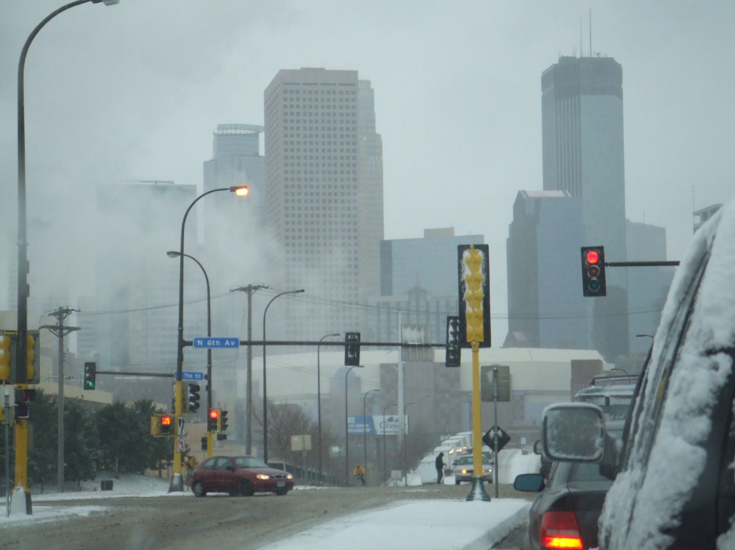
Minneapolis

Slide 6
Dogs
Oftentimes the personalities of dogs are misunderstood. People tend to forget that dogs have brains, can think for themselves and have their own traits that cannot be trained. Dogs can be very dangerous and should be treated as such.

Slide 7
Dogs
In my life I have constantly been surrounded by pets, my favorites being dogs. Their ability to listen and absorb information makes them fairly easy to train. They want to love, but sometimes need to learn how to do so.

Slide 8
Grandma
My Grandma is old and cannot move around much. She needs help doing many things around the house and because she cannot reach the shelves, we all had to move her dishes onto the counter. Many friends and neighbors bring her meals to avoid having her cook and potentially hurt herself.

Slide 9
Grandma
My Grandma constantly reminds my entire family how much she loves us. She writes us letters on our birthdays and calls us when she hears good news about us. Whenever we are having a bad day, she is the person to call to bring our spirits up. My grandma doesn’t have a mean bone in her body.

