Slide 1

Investigating Internet Safety
Tips and tools to keep you and your information safe on-line.
We will go over a lot of information today, so it is important to pay attention and follow along.

Slide 2
Why is Internet Safety important?
Prevent identity theft
Avoid damage to your computer
Prevent losing money to scams
Avoid getting junk mail at your house or in your email

Slide 3
What is a Virus?
What is a computer Virus?
It is a computer program or file that can make your computer “crash” and could permanently damage it.
What does it do?
It can infect your computer with harmful information and invades your files, making copies of them. It is possible to spread to multiple computers by sharing information.

Slide 4
How do I know if I have a Virus?
Your computer is working much more slowly than usual
People are receiving emails from your account that you have not sent
Your computer is shutting down, restarting or performing actions you have not requested
Programs or files are being deleted or copied

Slide 5
What can I do about it?
Prevention
Do not click on
pop-ups or advertisements.
Do not open emails from people you do not know.
Do not use websites that download music and videos illegally
If you notice problems:
Stop downloading files,
Don’t send emails from your computer
Do not submit personal information on sites until you have taken care of the virus!

Slide 6
How do I protect my computer from viruses?
Use Anti-Virus Software:
Software that prevents and detects computer viruses.
What does it do?
  Keeps viruses and other damaging software from entering or harming your computer.
  Scans incoming information from the Internet, attachments and Emails.
  Run and update this software regularly to make sure it is performing as it should be.
Running a “Scan”
Searches all your programs, files and folders for viruses and harmful software.
Make sure you are using the most up to date version of your Anti-Virus to get the best results

Slide 7
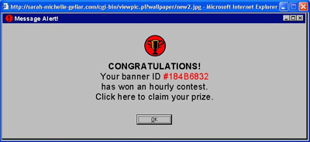
How would you deal with this on your computer?

Slide 8
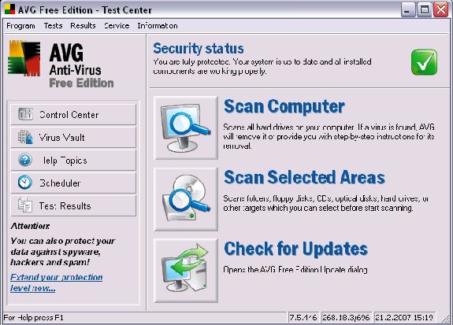
Example of Anti-Virus Software

Slide 9
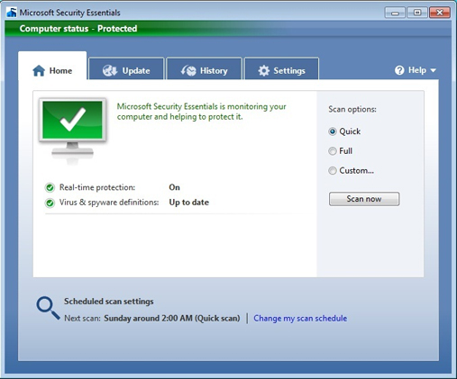
Example of Anti-Virus Software
Microsoft Security Essentials- For PC’s

Slide 10
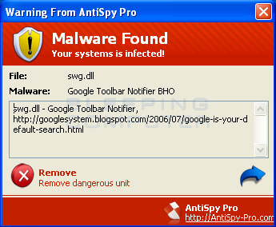
What are Pop-Up Ads?
A smaller window that appears over a the information you want when you are using the internet
Often pop-ups are advertisements designed sell a product or get more internet traffic to a website
Some pop-ups will ask for email address and other personal information
Some pop-ups can spread computer viruses

Slide 11
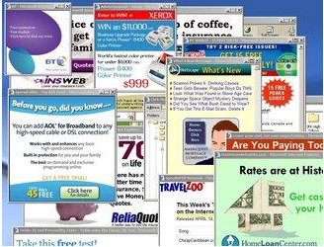
Examples of Pop-Up Ads

Slide 12
What Can I do about Pop-Ups?
Most of the time you can close the ads using the X and continue using the internet
Sometimes the close option is a fake X and will lead to more advertisements
  Pay attention to the changes on your screen when you close a pop-up ad
You can use your keyboard to close the browser if there are many pop-ups
  ALT + F4
  CTRL + SHIF T+ ESC

Slide 13
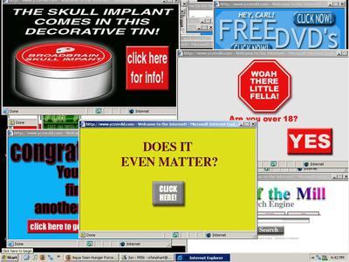
Press Alt + F4 to close the browser
Use Alt + F4 to close the active window without using the mouse.

Slide 14
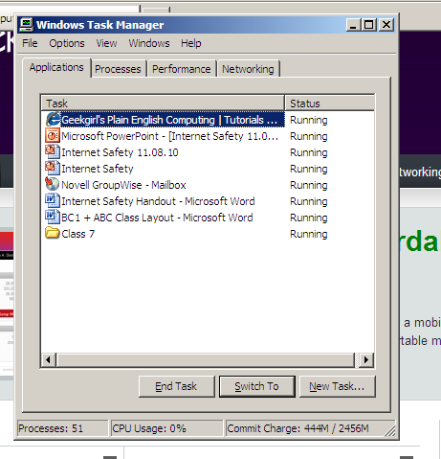
How do I get rid of Pop-Up Ads?
CTRL + SHIFT + ESC opens the Task Manager, which will show all the tasks running.
Select the pop-up
Click “End Task”
Close the Task Manager

Slide 15
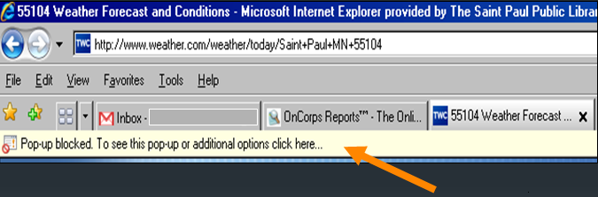
Pop-Up Blocker
Internet Explorer and other web browsers often have a built in Pop-Up Blocker to prevent Pop-Ups from appearing on your computer.

Slide 16
Let’s update our pop-up blocker
GO TO GOOGLE.COM
  What keys words would be typed in if I was looking for information on blocking pop-ups?
    Block pop-ups
    Click on the windows.microsoft.com link
      Read through the directions for how to block pop-ups

Slide 17
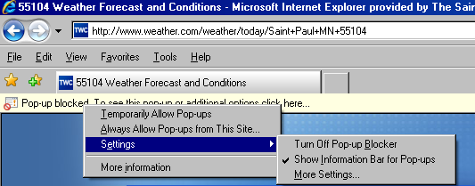
You can disable or turn-off a Pop-Up Blocker if you need to view a Pop-Up. You can do this by clicking on the Pop-Up Blocker.
Only turn off the Pop-Up Blocker for websites you trust
You many need to access a pop-up for a form, a verification, or to view something you need to print

Slide 18
Personal Firewalls
What is it?
A type of software used to keep out bad Internet information
  for example: hackers or viruses
Helps keep personal information safe while using the internet
How do I use it?
A free firewall is usually a part of the operating system on your computer
  Often a firewall will be turned on automatically
Firewalls work best when updated regularly and used with anti-virus software
Firewalls have options to set the level of security you want

Slide 19
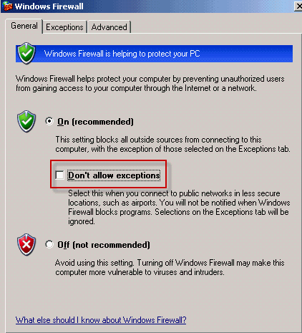
Example of Firewall settings

Slide 20
THE BIGGEST CLUE ON THE INTERNET
HTTPS:// means that this is a secure site, you could share personal information through this site
(banks, government sites, shopping, etc)
HTTP:// is not secure This is not a secure site for sharing private information (bank info, social security, credit card numbers, etc.)

Slide 21
Keeping Kids Safe on the Internet
Be a nosy parent
    What sites are your kids looking at? Who are they talking to? Is their use age appropriate?
Are they keeping personal information private?
    Passwords, home address and phone number
Are they smart about their sharing?
    Many things posted on the Internet (Facebook, Myspace, Instant Messenger) can be copied and shared without permission
    They may not be as anonymous as they think they are

Slide 22
Internet Safety Tips
Only enter personal information into trusted and secure sites
Scan and update
anti-virus and firewall software often. If it’s not up to date, it may not be doing its job
Beware of downloading music, movies and other files
Take care of your computer! If it is telling you it needs an update or other routine maintenance, take time to do these things

Slide 23
Internet Safety is about…
Common Sense
    Don’t click on or respond to things that are suspicious.
Keeping your personal information secure
Reading the Screen
    Be aware of what’s happening on your computer, read the screen and pay attention
Getting Help
    Ask for help from a friend or professional
    Do your own research to know how to keep yourself and your family safe on-line

Slide 24
Any questions?

