Slide 1
Introduction to the Computer
Notes:
This is a very basic introduction to computer vocabulary. Specifically, the parts of the computer we will use in class.

Slide 2
Hardware
Parts of the computer that you can physically touch
Notes:
Learners should write down Hardware

Slide 3
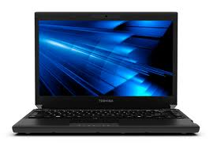
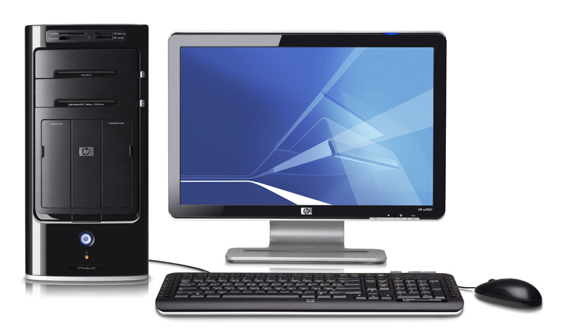
Types of Computers
Laptop
Desktop
Notes:
Learners should write down Laptop and Desktop
Desktop- parts are external
Laptop- parts are all within the small, portable frame of the computer

Slide 4
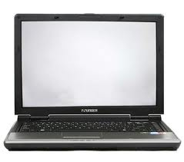
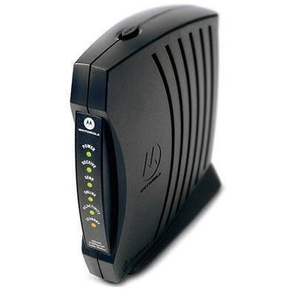
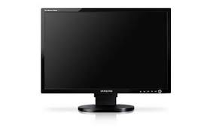
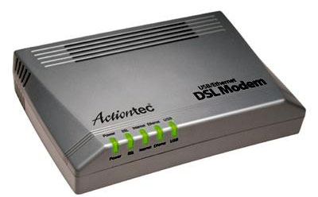
Monitor
Modem
Notes:
Learners should write down monitor and modem
The monitor is what displays information; it is the screen of your computer.
Question: what allows you to move around the computer and open
Modem: A device that enables computer to transmit data over, for example, telephone or cable lines.
They can be found both inside the computer and externally. Ask students if anyone can name a type of modem or what kind of data it transmits.
Internet
Cable

Slide 5
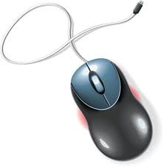
Hardware we use in Class: Mouse
It moves the cursor around the screen
Clicking
“Click”
Right-click
Opens menus
Touchpad on laptops
External
Cord or Wireless
Notes:
Learners should write down mouse
Demonstrate how to properly hold the mouse: buttons forward, pointer finger on the left button, middle finger on the right button
When someone tells you to “click” on something, simply use the left button
If they want you to use the right button, they should clarify by saying “right-click”
Right click opens up “menus”- demonstate by right clicking in the slide
A mouse can be on the outside of the computer or directly placed on the computer, like the touchpad on laptops

Slide 6
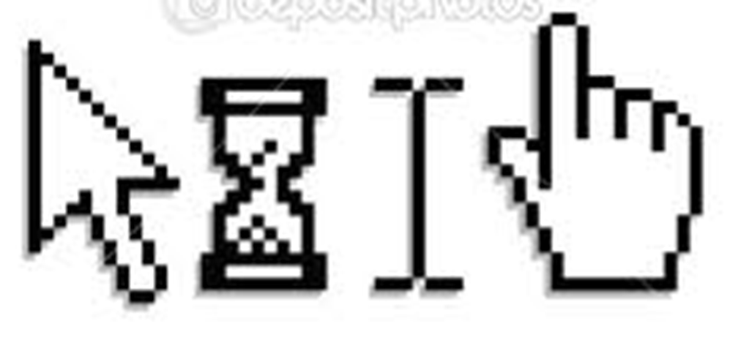
Cursor
A few different cursors
Search
Loading
Cursor is over a hyperlink
Edit
Notes:
Learners should write down cursor.
There are four key types of cursors.
Navigates you around the computer
This signifies that something is loading, so do NOT continue clicking on it. On many computers this looks a little differently now. Sometimes it is an arrow with a circle next to it, other times it can simply be a circle that looks like it is rotating
This cursor signifies that you can type in a space. You will see this on the internet when you are in the address bar to type in a website.
This cursor will be incredibly relevant to this class. We will see this little hand all the time. It signifies a hyperlink, which we will discuss more later on. Basically, a hyperlink is something you can click which will move you from where you are to some place else.

Slide 7
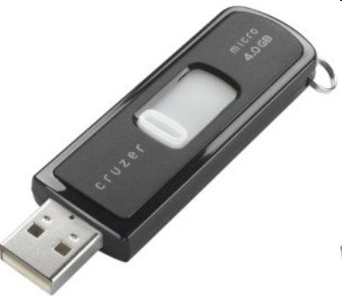
Hardware we use in class:
USB Flash Drive
Notes:
USB Drives go by many different names= flash, thumb and so on
In the most basic terms, it is a storage device that allows users to save documents/spreadsheets/PowerPoints and take them along wherever they go.
Ask why this would be beneficial? You can update work at any computer, keep your work, smaller than transporting a computer
Explain that we will not use USB drives in the Internet class, but they are useful to know about for personal use.

Slide 8
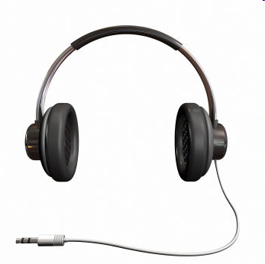
Hardware we use in class:
Headset
Notes:
Ask what headsets can be used for: listening to sound to yourself.
If you want to have the sound on for Mavis Beacon, you can use headphones. There are two days during the class that we will definitely use headphones, but other days it will depend on the content you find online.

Slide 9
Software
The stuff you can’t touch with your hands, but CAN touch with your cursor.

Slide 10
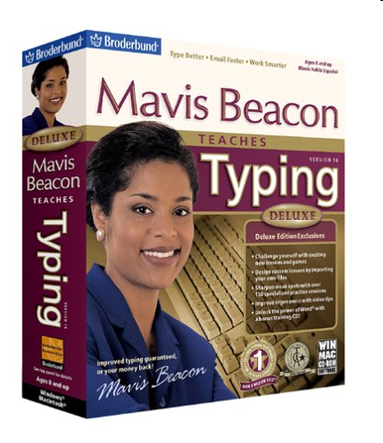
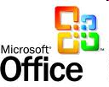
Software
Definition
Software we use in class:
Instructions in the computer that help it do different tasks
Microsoft Office
Mavis Beacon Teaches Typing
Notes:
Do any students know what Software is?

