Slide 1
Internet Review

Slide 2
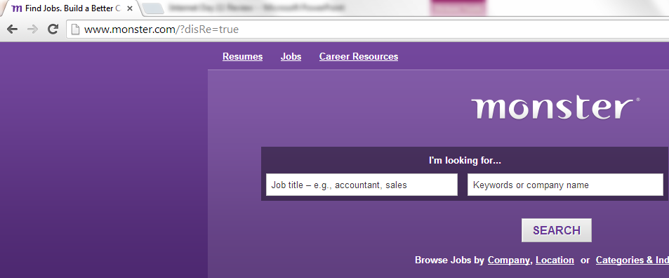
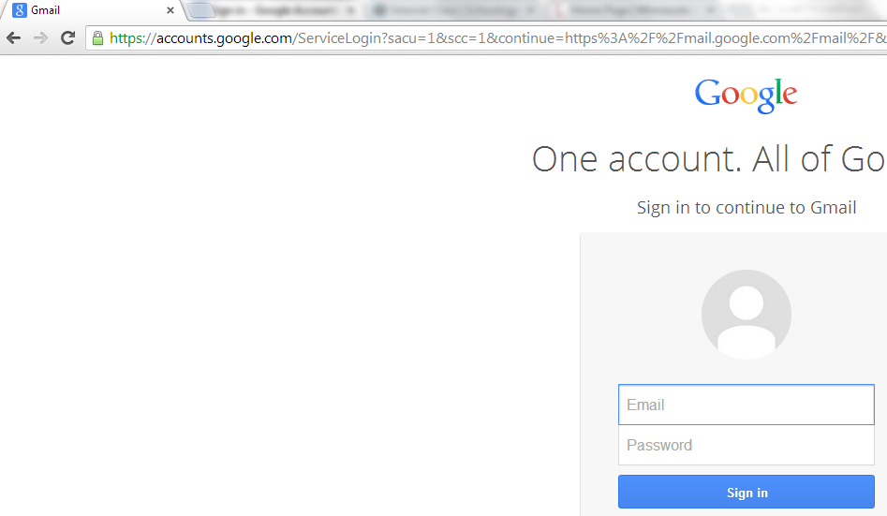
Which of the websites shown below is secure, how do you know?
Notes:
Gmail, because of the httpS in the address bar. The “S” means SECURE.

Slide 3
Can you write the names of the common web browsers?
Notes:
Internet Explorer, Google Chrome, Mozilla Firefox, Safari

Slide 4
What are the names of the common search engines?
What do you type into a Search Engine?
Notes:
Common engines: Google, Bing and Yahoo
Type in: Key Words!

Slide 5
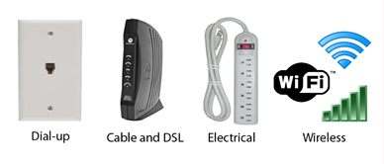
Circle all of the pictures that depict a method that allows you to connect to the internet.
Notes:
All but the electrical option.

Slide 6
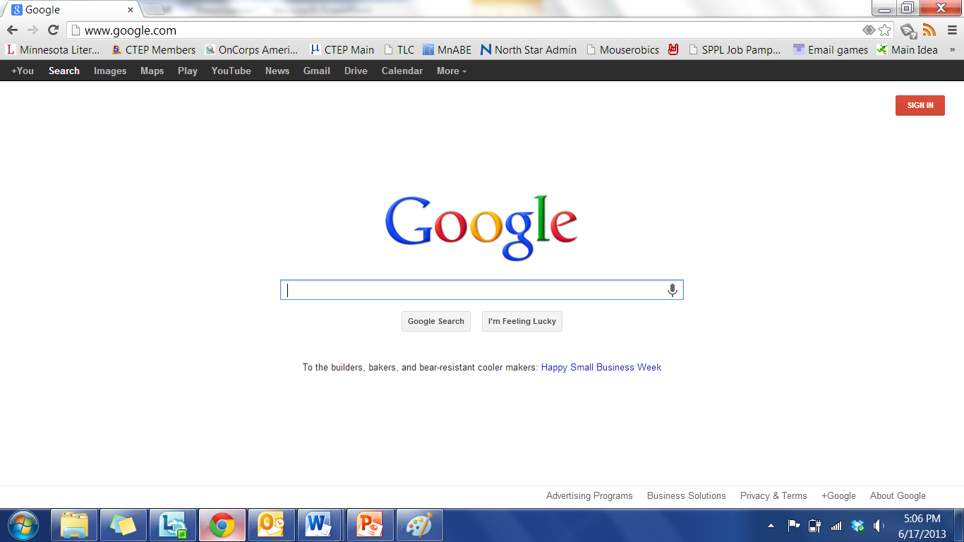
Circle the space where I would type in Facebook.com.

Slide 7
Circle the space where I would search for information on “jobs in Minneapolis”.

Slide 8
What is a Computer Virus?
What is Antivirus Software?
Notes:
Virus: a program that copies itself and infects a computer
Antivirus: Detects and protects against Viruses

Slide 9
Which icon signifies the tool that stops a page from loading all the way?
Notes:
The red X

Slide 10
Which icon will take you to the home page?

Slide 11
Where do you click to create a new tab?

Slide 12
Remember to listen to the WHOLE question. The question will give you hints about where to find the answer and occasionally will tell you how to move forward after you have answered. If you missed an important part of the question, remember to look for the blue ear.

