Slide 1
Day 11 Review
Notes:
Explain that this Review is meant to point out that the answers will be on the page, sometimes you just have to scan for them.
Explain that what students need to take away from this is a basic understanding of common vocabulary words that should be written on the board.

Slide 2
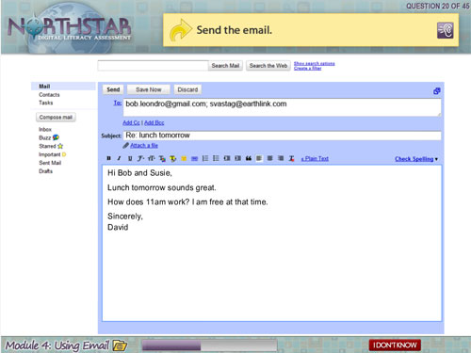
Where would I click to send an email?
Notes:
This is a practice example.
Explain that even though learners have not learned how to use email in this class, they can use their scanning skills to search for the answer on the page.
How would someone go about sending an email? What words are we looking for? Instruct students to circle the spot they would click that would answer the question.

Slide 3
What program does this Icon open?

Slide 4
Where is the Start menu?
How many programs are open on the taskbar?
How would I open the Excel spreadsheet from the taskbar?
Notes:
Explain that on newer versions of Windows, the start menu does not say Start, instead it simply shows the Windows icon.
Point out that it is still in the same spot, that has not changed.
Programs open on the taskbar? 4
How to open Excel? Click on green icon on the taskbar.

Slide 5
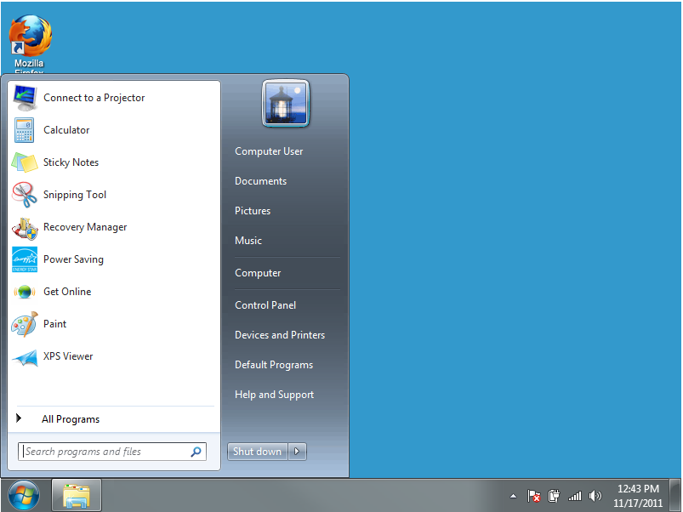
Where would you find the Control Panel?
What are some features that are different in this Start menu than on others?
Draw a star on the taskbar.
Search feature.
Draw a star on the desktop.
Notes:
Again, students can use scanning to find the answer.
What words are we looking for? Control Panel
Click, and control panel will be circled.
Differences? Search bar does not exist on the Windows version we use. Shut down buttons are different.

Slide 6
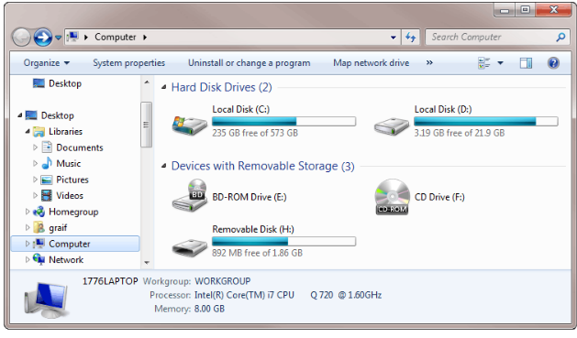
How many hard drives are shown below?
Notes:
What is a hard drive? A self-containing storage device.
Do they see a label that will help them find the answer? Use the screen, there are hints everywhere.
Answer: two.

Slide 7
Which icon would open Microsoft Word?
What can be created in Microsoft Word?
Documents
Notes:
Ask if these are Microsoft Office Programs? Yes.

Slide 8
Which file extension would open a Word Document?
Recycling.ppt
Recycling.doc
Recycling.xls
Notes:
Explain that these are not things we have learned, so try to really think about and sound out the extensions. If we say them out loud, it might become clear what program would be opened.
Answer: B. Doc=document

Slide 9
Which file extension would open a PowerPoint Document?
Recycling.ppt
Recycling.doc
Recycling.xls
Notes:
Answer: A. PPT=PowerPoint

Slide 10
Which file extension would open a Excel Spreadsheet?
Recycling.ppt
Recycling.doc
Recycling.xls
Notes:
Answer: C. xls: Excel Spreadsheet (sound it out)

Slide 11
Where do I click to minimize the Window?
Where do I click to maximize the window?

Slide 12
Anyone know how to open the Windows Explorer Folder in the taskbar?
What are some key words? Hints as to where you can find the answer?
Folder
Taskbar
Notes:
This is a lesson in using clues. The question provides us with clues about how to find the answer.
What are key words? Folder and taskbar. They tell you what to look for and where.

Slide 13
Things to remember:
Listen carefully to the question and then read it at the top of the page to identify hints and key words that will allow you to locate the answer.
The answers are on the page, you just have to look for them.
Stay calm! If you get confused by a question just breathe, and remember you can listen to it again if you need to.
Notes:
Explain that students should try their best, but should not get overwhelmed with the need to pass. This test is not telling of what they have learned in class and will not be a judge of their knowledge of material covered.

