Slide 1
Introduction to the Computer
Day 1 of Email Unit

Slide 2
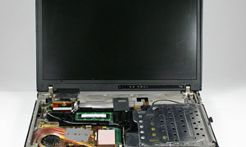
Hardware
The parts of the computer that you can physically touch.
We will only be going over the parts of the computer that are relevant to this class.

Slide 3

Laptop

Slide 4

Mouse
Navigates the cursor around the computer
Two buttons and a scroll bar
Click-left click
Double-click
  Use left button
  Opens Programs
Right-click
  Opens menus
Notes:
Point out the two buttons on the computer.
Explain, that when someone tells you to click on something, you assume they mean to use the left button. People typically clarify if they want you to right-click
Explain that learners will use double-click every day to open up the Internet Browser
Demonstrate using right-click on this slide to show the menu that pops up.

Slide 5

Cursors
Cursor is over a hyperlink
Search
Loading
Edit
Notes:
The mouse moves the cursor around on the screen. I am going to introduce you to different forms of the cursor, though their use and shape will become more clear once you practice on the computer a bit more.
1. Basic arrow, this is what you will see as you move around the computer. It opens and closes programs as well as other things.
2. If you see a cursor like this hourglass shaped one, it means that a program or website you clicked on is opening. Currently, the loading cursor tends to look different. Now, you might see an arrow like the search cursor with a circle next to it.
The edit cursor informs you when you can type in a space and informs whatever program you are in that you are editing text.
The final cursor will take you to a new page on the internet. It informs you when there is a hyperlink. This will come in handy during out internet day.

Slide 6

Headphones
For listening
Where to plug in?
  Headphone jack
Notes:
Have students locate the place where their headphones should be plugged in.

Slide 7

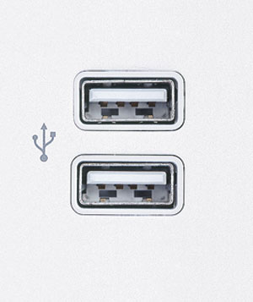
USB Drive
USB, Flash, Thumb
Stores documents created
USB Port
Notes:
These will only be used a couple of days during this class.
Explain that the USB Drive plugs into the USB port, ask learners to locate all of the USB ports. How many are there?

Slide 8

Software
The tools in the computer that allow you to do…stuff.

Slide 9

Internet Browsers
A web browser is a software application for retrieving, presenting, and traversing information resources on the World Wide Web.
You open a BROWSER to gain access to the INTERNET

Slide 10
Microsoft Word
What is it used to create?
  Documents
    Resumes
    Letters
    Anything with text
This program will be used later in class
Notes:
Ask learners to answer the questions before you show options
Word will be used a few days into the class as we create documents to attach to emails-if students do not know what that sentence means, tell them they will by the end of the class

Slide 11
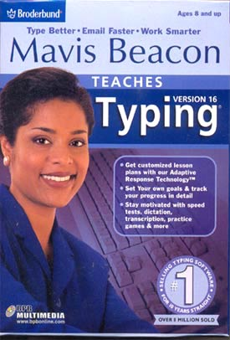
Mavis Beacon
Typing software
You can come to class at 6 pm to use it
  Highly recommended
Notes:
Explain that typing is essential to success on the computer. As students will see, things like going to a website can be frustrating if you do not know where keys are or do not realize that you typed the URL incorrectly.

Slide 12
What is Email?
Notes:
So where does email fit into all of this?

Slide 13
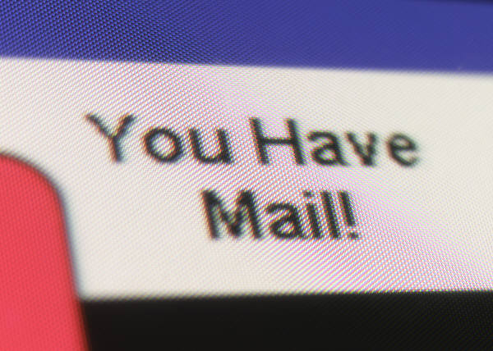
Email
Is email Software or Hardware? Why?
  Software
What is Email?
  Email is electronic mail
Notes:
Ask learners what they think it is before you should the answer.
Email

Slide 14
Email
What are some benefits of using email over regular mail (post)?
Notes:
Ask students to raise their hand one at a time to offer ideas of why using email is beneficial? This could lead into why they wanted to take an email class.
Options:
Faster
Easier-after practice
Cheaper
Professional

Slide 15
Email
Email service providers
  We will use Gmail, why?
    Professional credibility
Who already has a Gmail account?
Notes:
Explain that there are many email service providers
Ask who in the class already has an email address? Ask who their email service provider is?

Slide 16
Parts of an email address
kelly.jackson@gmail.com
Username
Email Service Provider
Notes:
First ask, is this an email address?
Explain that there are different parts to an email address
Click and circle should appear over gmail.com
Review: what is this part of the email called? What does it tell a user? Email service provider?
Click and answer will appear
Click and circle will appear over @ sign
Ask why this symbol is significant? Tells user it is an email address
Ask how to create the @ symbol? Shift+2
Take minute to explain that when there is a key with two symbols on it, if you simply click on the key, it will display the lower symbol, but if you press shift and then the key at the same time, it will give you the upper symbol
Click and circle will appear over kelly.jackson
Ask if anyone knows what this part of the email is called: username
What is a username? It is was makes your email address your own. It is your personal address within the Gmail service
Example: if you were going to visit someone’s house, you would need their address exactly, otherwise it will take you to the wrong place
The username is your address in the world of email

Slide 17

Email
Email versus web addresses
  Email includes @ sign
  NEVER any spaces in either
Which of these is an email address? How do you know?
Notes:
Go to next slide for examples

Slide 18
Parts of an email address
jerryjohnsongmail.com
computerliteracy@mnliteracy.org
Notes:
Ask if this is an email address?

Slide 19
Username Rules
Usernames can tell people a lot about you
  Identify who you are-form of your name
  NO informal self descriptions
    IE: talltimmy05, catlover, sexysandy
  Keep it simple
  Numbers are okay, other non-letter characters should be avoided
  Do not use private information
    Social security numbers, bank account

Slide 20
Password Rules
Nothing too common
Include 1 uppercase letter and one number
Never the same as username
At least 8 characters
Avoid generic information about yourself
Note: We will be going over Email safety at a later date.

Slide 21
Let’s open up an Internet Browser!

