Slide 1

Critical Reading
How to take your reading to the next level….
Critical Reading Steps Modified from: Salisbury University: 7 Critical Reading Strategies

Slide 2
What does Critical Reading mean?
On a sheet of notebook paper, take one minute to try to write down a definition for Critical Reading.
Now, turn to a partner and pair-share your definitions.
What do you think? Share as a class what you think Critical Reading means.

Slide 3
CRITICAL READING:
Definition: Critical Reading is the opposite of careless reading. Critical Reading means to read carefully, thoughtfully, and with a purpose in order to better understand and evaluate a text.

Slide 4
Are you a Critical Reader?
How do you usually read a text? Do you take notes? Skim? Read quickly? Turn to the person next to you and share your current reading process.

Slide 5
Where does Critical Reading fit in our C.A.R.E. Model?

Slide 6
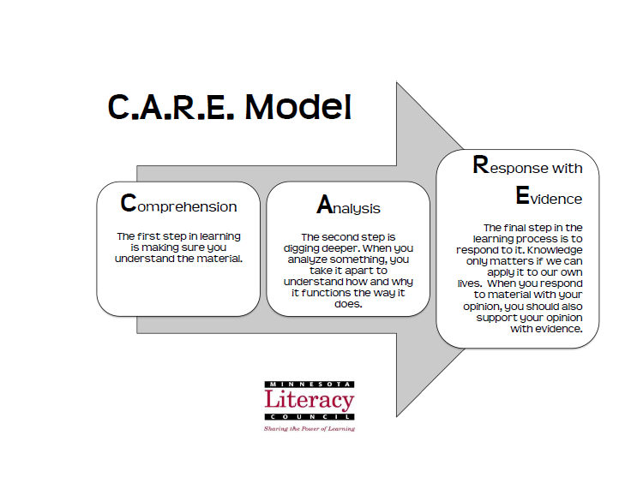

Slide 7
Yup. Comprehension. Reading Critically helps us to better understand or comprehend, the text.
It also prepares us for the next steps of the C.A.R.E. Learning Model.

Slide 8
4 Steps to Becoming a Critical Reader
Preview: Skim before you read
Contextualize: Where does it fit?
Ask Questions to Understand and Remember
Identify the Main Ideas and Restate them in your Own Words

Slide 9

1) PREVIEW:
Learning about a text before you read it
What can you learn about the text before you ever read it? Take a look at titles, headings, bolded words, and pictures.

Slide 10

TRY IT
In pairs, practice previewing today’s reading. What did you find?

Slide 11
Read through the passage for the 1st time
Remember, when reading critically, you’ll usually want to read through a passage more than once. Read the first time through just to get a sense of the overall content and shape of the passage. Do not take notes.
Today we will read completely through this passage fully two times.

Slide 12

2) CONTEXTUALIZE:
Placing a text in its historical, cultural, and biographical context
When you read a text, you read it through the lens of your own experience. Your understanding of the words on the page and their significance is informed by what you have come to know and value from living in a particular time and place. But the texts you read were all written in the past, sometimes in a radically different time and place.

Slide 13
2) CONTEXTUALIZE:
Placing a text in its historical, cultural, and biographical context
Ask yourself:
When do the events in the the reading take place?
Where do the events in the reading take place?
How might the people I’m reading about have similar or different experiences than my own?

Slide 14
TRY IT
In pairs, practice Contextualizing today’s reading.
When do the events in the reading take place?
Where do the events in the reading take place?
How might the people I’m reading about have similar or different experiences than my own?

Slide 15

3) QUESTIONING:
Asking questions to understand and remember
As students, you are used to teachers asking you questions about your reading. These questions are designed to help you understand a reading and respond to it more fully.
When you need to understand and use new information though it is most beneficial if you write the questions, as you read the text.

Slide 16
3) QUESTIONING:
Asking questions to understand and remember
With this strategy, you can write questions any time, but in difficult academic readings, you will understand the material better and remember it longer if you write a question for every paragraph or brief section. Each question should focus on a main idea, not on illustrations or details, and each should be expressed in your own words, not just copied from parts of the paragraph.

Slide 17
TRY IT
Read through the passage a 2nd time. In pairs, practice Questioning today’s reading. What questions do you have about the reading? After each section, write a question.

Slide 18

4) IDENTIFYING MAIN IDEAS:
Identifying the main ideas and then restating them in your own words
Outlining and summarizing are especially helpful strategies for understanding the content and structure of a reading selection.
Outlining reveals the basic structure of the text
Summarizing restates a selection's main argument in brief, often in paragraph format
The key to both outlining and summarizing is being able to distinguish between the main ideas and the supporting ideas and examples. The main ideas form the backbone, the strand that holds the various parts and pieces of the text together. Outlining the main ideas helps you to discover this structure.

Slide 19
TRY IT
In pairs, practice Identifying Main Ideas from today’s reading by outlining it. Look at the text a 3rd time.
Go back through the reading, and write a one sentence summary of the main idea of each section.
(Note: Do NOT include your opinion in this step)

Slide 20
So…what’s the reading about?
After you’ve worked with your partner to write an outline of the article’s main ideas, take your notes with you and SWITCH PARTNERS.

Slide 21
So…what’s the reading about?
Now…the test. Pretend that you are in an elevator with your new partner. You’ve just read a really interesting article (the one we just read for class) and you want to tell them about it. The trick? You’ve only got 30 seconds before the elevator ride is over….

Slide 22
So…what’s the reading about?
In 30 seconds, tell your partner what the reading is about.
Time is limited. Tell only the most important parts.
Use your own words
You may use your notes/outline to help you.
Switch roles and let your partner try.

Slide 23

What do you think?
Do you feel like you understand the reading better after this process?
Pair-share

Slide 24
Why is Critical Reading Important?
In your notebook, list as many reasons as you can think of concerning why critical reading is important.
Pair-share

Slide 25
Now that you’ve Critically Read the passage, you’re ready to move on to the next steps of the C.A.R.E. Learning Model.
Critically Reading a passage will give you the base to be able to Critically Think about and respond to it.
The steps of Analyzing, Responding, and Responding with Evidence in the C.A.R.E. model will ask you to employ these critical thinking skills.

Slide 26

Wrap-UP
What is one thing from today’s passage or critical reading lesson that you will take away from today? Write it down in your notebook.
Pair-share.

