Slide 1
Tell the audience what to expect
Accessibility Basics Tutorial

Slide 2
At live events
Help people anticipate what they need to participate
Reduce and manage anxiety

Slide 3
Share slides and handouts
Provide access to the contents of slides and handouts for people who can’t access or process that content during the live event.
Share in advance wherever possible for equity.
Share after the event if necessary.

Slide 4
Share an agenda
Share before the event if possible.
If sharing at the beginning of an event, take a short break immediately after.
Stick to the agenda. Explicitly acknowledge deviations.

Slide 5
Preview transitions
Alert people to changes that they may need to prepare for
Changes in format:
Single speaker to panel
Live speaker to recorded video
Lecture to Q&A
Zoom to Jamboard
Changes in sensory environment:
Turning lights on or off
Turning music on or off
Turning AC, heat, or fans on or off
Participatory activities

Slide 6
For written and recorded formats
Help people discern what they’ll find in the resource.
Help people discern where they’ll find what they’re looking for.
Make the resource scannable for people who can’t scan visually.

Slide 7
Document outlines
Put a Table of Contents within the body of the document.
Break your document into sections with headings.
Automatically generate a Table of Contents based on headings.
Create bookmarks.
For Word/Docs: Insert > Bookmark
For PDF: Save as > PDF > Options > Create bookmarks from headings

Slide 8
Video timestamps

Slide 9
Link text
Replace raw URLs with text
Make the text informative when read in isolation
Here’s a recipe for Somali rice:
https://tasty.co/recipe/somali-bariis-as-made-by-amal-dalmar
Click here for a Somali rice recipe.
Read a Somali rice recipe.

Slide 10
Provide multiple ways to communicate
Accessibility Basics Tutorial

Slide 11
Communication principles
Be flexible & ready to improvise
Expect people to use different methods in different situations
Don’t pretend to understand something if you haven’t

Slide 12
Speaking
Say your name before speaking.
Allow the audience to unmute on Zoom for questions and comments.
In person, make sure all speakers speak into a mic.
If not possible, make sure someone with a mic repeats questions and comments for the whole audience.

Slide 13
Typing
Read comments from the Zoom chat aloud.
In person, provide a number where participants can send a text message to ask a confidential question or request help.
In conversations with an AAC user, expect to move at a slower pace and allow plenty of wait time for the AAC user to compose their message.
Average words/minute in speech: 150-170
Average words/minute in AAC: 15
Read more tips from AssistiveWare about facilitating successful communication with AAC users.

Slide 14
Handwriting
In person, have pencil and paper so audience members can take notes or submit written questions or comments.
Offer access to tools that make handwriting more comfortable.

Slide 15
Signing
See the section on ASL interpretation

Slide 16
Use Plain Language
Accessibility Basics Tutorial

Slide 17
Why use plain language
Helps communication reach a wider audience
Benefits English language learners
Benefits neurodivergent people
Benefits people with cognitive disabilities
Shows respect for your audience’s time

Slide 18
When to use plain language
When you’re communicating specific information
When you’re teaching a specific skill

Slide 19
What is plain language?
Term of art
Referenced in federal law and policy
Direct
Clear
Concise
Literal

Slide 20
Direct (a)
Don’t make people guess what you mean.
That’s interesting.
That’s weird.
That’s fascinating.

Slide 21
Direct (b)
Don’t disguise instructions or requirements as suggestions.
It would be great if you could finish this by tomorrow.
Please finish this by tomorrow.
Don’t disguise questions as statements or vice versa.
It would be great if you could let me know what you think.
What do you think?

Slide 22
Direct (c)
Don’t hide the true subject of a sentence. (Avoid passive voice.)
Treaties were broken.
The U.S. government broke treaties.
Don’t hide the true verb of a sentence. (Avoid nominalization.)
We are responsible for the management of the program.
We manage the program.

Slide 23
Clear
Don’t use the same word to mean different things.
Go right after the stop sign? Yes, that’s right.
Go right after the stop sign? Yes, that’s correct.
Don’t use different words to mean the same thing.
We pay taxes to the government. The state uses taxes to pay for schools.
We pay taxes to the government. The government uses taxes to pay for schools.

Slide 24
Concise
Prefer shorter and simpler sentence constructions.
Prefer shorter and simpler words.
Choose Germanic words instead of Latin and Greek borrowings.

Slide 25
Literal
Avoid euphemisms.
Use figurative language in addition to the literal, not instead.

Slide 26
Plain language resources
Hemingway Editor
Federal plain language guidelines
Clear Language Lab

Slide 27
Create a navigable document structure
Accessibility Basics Tutorial

Slide 28
Headings
Break up text into sections and subsections. Improves readability!
Give each section a heading. Improves navigation!
Good headings are short, informative, and unique (no duplicates).

Slide 29
Use the built-in heading styles
These styles tell assistive technology that the text is a heading.
This allows assistive technology users to skip directly from heading to heading.
Failing to use the built-in heading styles defeats the purpose of headings.
You can change the visual formatting of a heading style as necessary.

Slide 30
Select the correct heading level
Heading level must be based on the logical structure of the document.
The main title is Heading 1. Only one instance of Heading 1 per document.
Main section headings are Heading 2s.
Heading 3s are subsections of Heading 2 sections. Heading 4s are subsections of Heading 3 sections. And so on.
Do not skip a heading level!
Do not choose heading level based on the default visual formatting of that heading style!

Slide 31
Use slide titles
Slide titles play the role of headings in a slide deck
Slide titles should be descriptive and unique (no duplicates)
Use the built-in slide title field

Slide 32
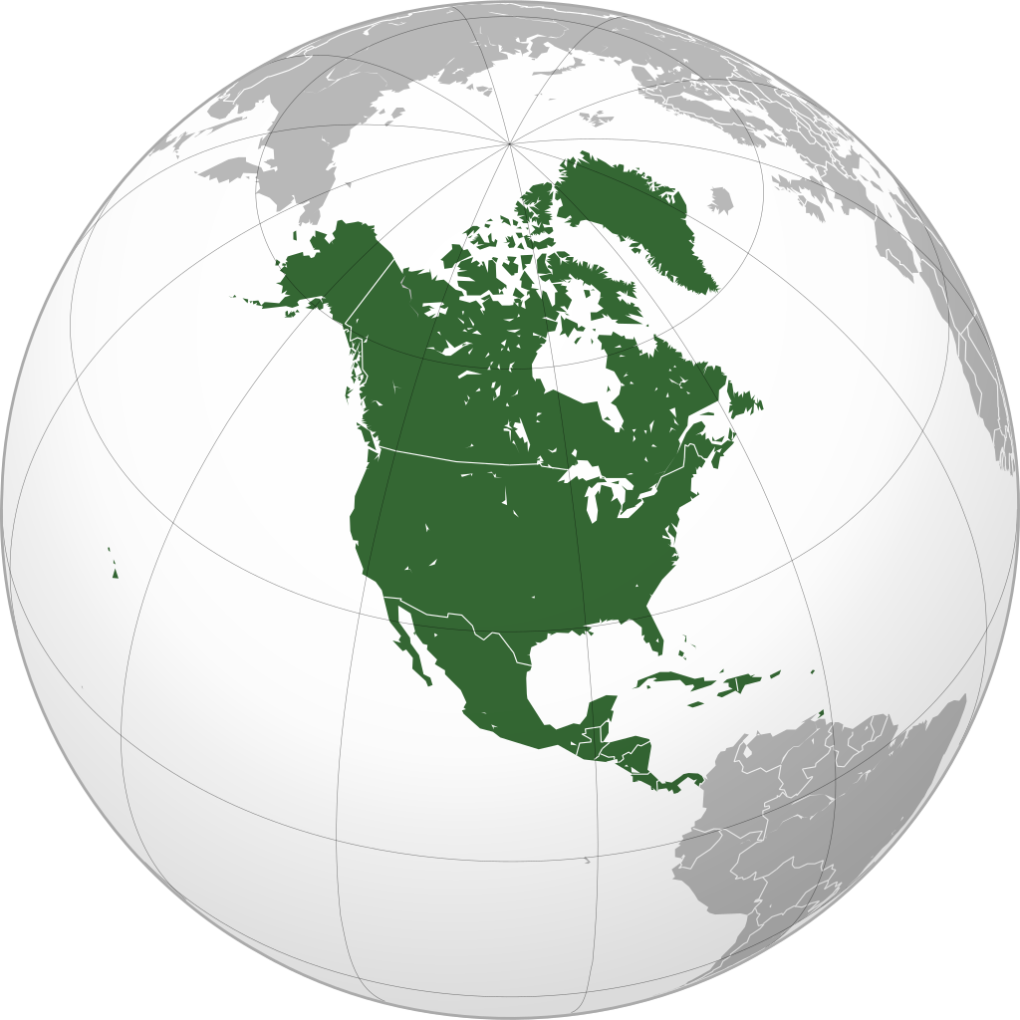
The Earth
Canada
United States
Mexico

Slide 33
Lists
Appropriate use of lists improves readability
Lists don’t improve readability when list items are too long
Use the built in list function. Microsoft and Google will automatically detect and apply this to handwritten lists, but Adobe wont!

Slide 34
Tables
Tables are inherently less accessible for assistive technology users because they communicate information based on a visual array
Only use tables for data, not for layout
Format tables as a simple grid with one header row
Avoid header columns, split cells, or merged cells
Provide alt-text for tables

Slide 35
Table layout
Cities | Montreal | Toronto | Minneapolis | Duluth
States or provinces | Quebec | Ontario | Minnesota | Minnesota
Countries | Canada | Canada | United States | United States
Header column
Cities | States or provinces | Countries
Montreal | Quebec | Canada
Toronto | Ontario
Minneapolis | Minnesota | United States
Duluth
Merged cells
Cities | States or provinces | Countries
Montreal | Quebec | Canada
Toronto | Ontario | Canada
Minneapolis | Minnesota | United States
Duluth | Minnesota | United States
Simple grid

Slide 36
Avoid PDFs if you can
PDFs are very common sites of failure for digital accessibility
If you can’t highlight text by clicking and dragging with your mouse, then the PDF is totally unreadable with a screen reader
If you export a PDF from Google Workspace, it will be very difficult to read and contain errors
If you export a PDF from Microsoft Office without applying specific accessibility measures, it will be difficult and unpleasant to read

Slide 37
Strategies for avoiding PDFs
Share a Word or PowerPoint file
Share a Google Workspace file
Publish a Google Workspace file to the web (audience can’t edit)

Slide 38
Strategies for improving PDF accessibility
Create a PDF in Microsoft Office by…
Composing the document
Running the Microsoft Accessibility Checker and applying the fixes
Generating the PDF via File > Save as PDF
Under Save as > Options, check “document structure tags for accessibility”
Use a PDF, but include the language “alternative format available upon request” wherever you distribute the PDF

Slide 39
Format text legibly
Accessibility Basics Tutorial

Slide 40
Font
Keep it simple
Arial
Tahoma
Veranda
Times New Roman
Avoid

Slide 41
Fonts for dyslexia
OpenDyslexic is a free font designed for dyslexia
Avoid

Slide 42
Size
12 pt or larger for documents
18 pt or larger for slides on personal computer screens
24 pt or larger for slides projected in person

Slide 43
Color
High contrast between text and background. Check contrast online.
AND: dark text against light background
Black text is best
Low vision readers benefit from maximum contrast: black text against white background
Dyslexic readers benefit from softening the contrast: black text against cream or grey background

Slide 44
Formatting
Avoid italics, underline, and all-caps.
For all-caps, use the built-in formatting effect. Don’t capitalize the letters with your keyboard.
Avoid bolding long stretches of text.
Preserve healthy white space. 1.5 or double spacing is best.

Slide 45
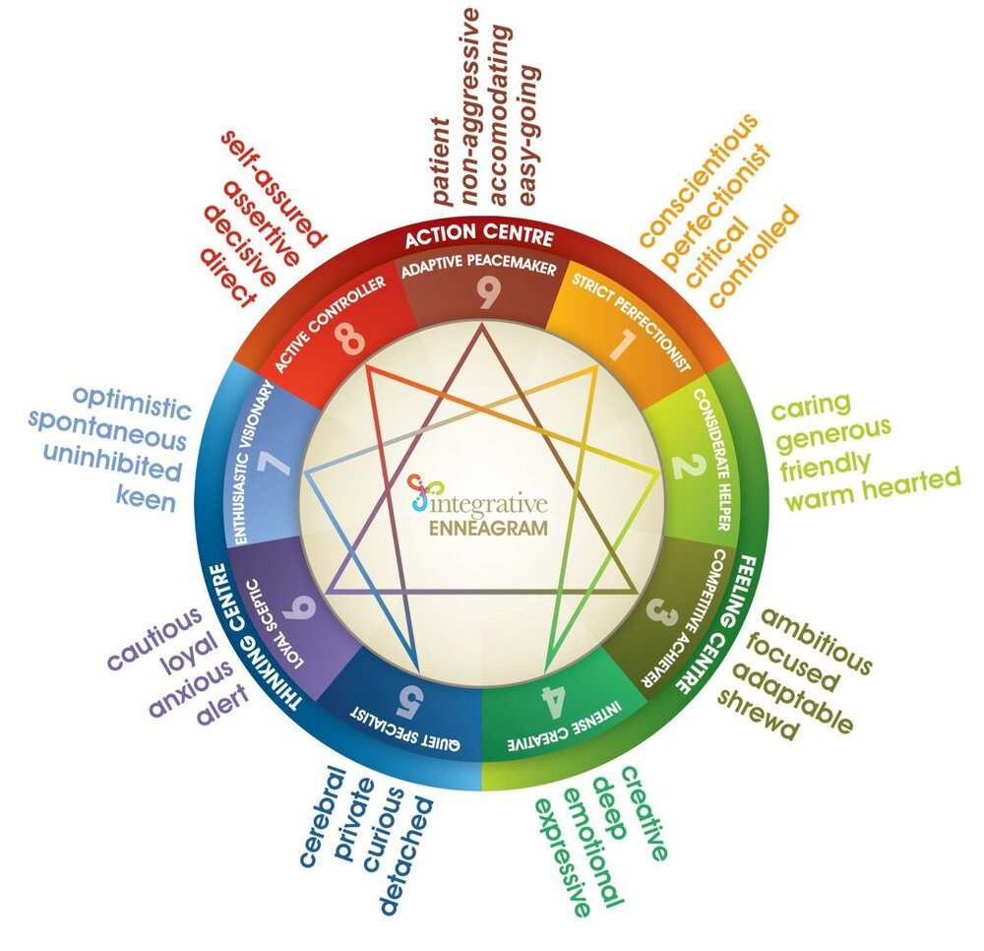
Placement
Left align text
Keep alignment consistent
Don’t justify text and keep spacing between words consistent
Remember that assistive technology users must read content in a single linear path
Avoid complicated multidimensional layouts like circles and spirals

Slide 46
Customization
No single text formatting will be most accessible for everyone
Share customizable formats and encourage customization of text display
The text display in Microsoft Office files is easily customized
The text display on web pages is easily customized with built in reader modes in web browsers or a free app like Helperbird
Paid apps like Voice Dream Reader allow text display to be customized in PDFs

Slide 47
Give visual descriptions
Accessibility Basics Tutorial

Slide 48
Alt text
Alt text is a short description of an image or graphic
Alt text gives blind people and assistive technology users access to the information and content conveyed by the image or graphic
All digital images require alt text, whether they are in documents, websites, or on social media

Slide 49
Creating good alt text
To add alt text, right click the image and select the alt text item in the menu.
Good alt text is:
Relevant and informative
Non-redundant
Concise
If you can’t capture all of the relevant content in a tweet-length alt text description, then put an image description into the body text.

Slide 50
Alt text examples
Abstract human bodies of all ages, shapes and sizes, including people using mobility devices and a service dog.
Literacy Minnesota
Literacy Minnesota logo
Mark as decorative

Slide 51
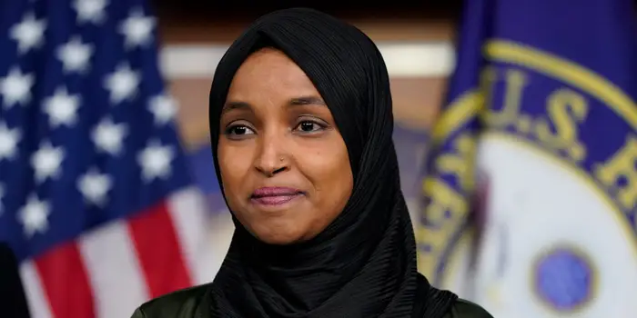
Complicated alt text examples
"Civil rights are not given. You must fight to get them, then fight to keep them. Anita Cameron" Three portraits of Anita, one wearing a beanie with the ADAPT logo, one sitting in a wheelchair and speaking into a bullhorn, and one lying prone while being arrested.
llhan Omar in front of U.S. and House of Representatives flags.
Close-up of Ilhan Omar, a Somali-American woman wearing a black hijab, smiling while posed in front of the U.S. and House of Representatives flags.

Slide 52
Visual descriptions for live events
Ensure access to information for participants who can’t see what’s happening.
A verbal description of yourself at the beginning of your speaking time
Verbal descriptions of the contents of slides throughout the presentation
Verbal summaries of important comments in the chat (in virtual settings)

Slide 53
Purpose of self-description
To provide audience members who can’t see you clearly with access to salient visual information about you that other participants have.
“Self-description is not a magic wand. It will never provide an equivalent experience to what a sighted person gleans from observation. It’s about providing access to information, increasing a Blind attendee’s opportunity to “observe” and participate.” Read more about the nuances of self-description.

Slide 54
Contents of self-description
Race or skin tone.
Gender.
Disability status.
Details about clothing, makeup or hairstyle that convey personality.
Background or setting you’re presenting from.

Slide 55
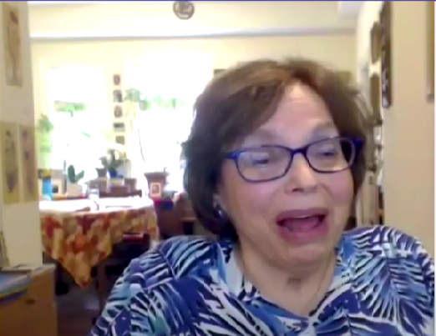
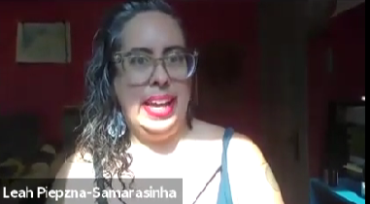
Examples of self-descriptions
“My name is Leah, L-E-A-H, Lakshmi, L-A-K-S-H-M-I, Piepzna, P-I-E-P-Z-N-A, Samarasinha S-A-M-A-R-A-S-I-N-H-A. I am a light sand colored, mixed Sri-Lankan-Roma-Irish nonbinary femme, with big, clear cat-eye glasses and pink lipstick and brown and grey hair in an undercut.”
Leah Lakshmi Piepzna-Samarasinha at Roundtable Discussion: Abolition and Disability Justice
“For my blind and low vision friends, let me explain that I’m a white disabled woman, I’m 73 years old, I have brown short hair, I’m wearing a blouse that’s different shades of blue and glasses, in the foyer of our apartment.”
Judy Heumann at the 2021 Friend of Education Award

Slide 56
Verbal descriptions of slides
Provide access to information on the slides
As with alt text, focus on only on relevant content conveyed visually and ignore pure decoration

Slide 57
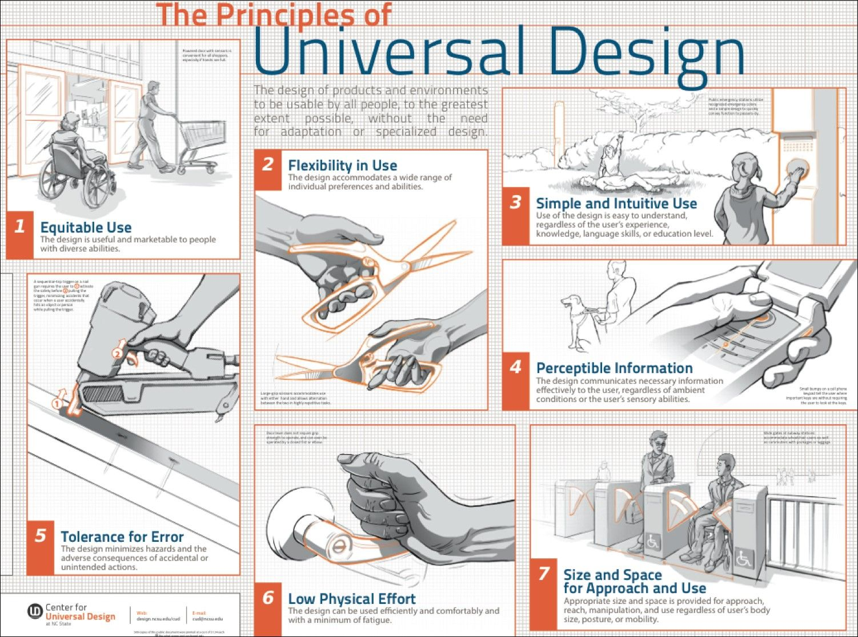
Universal Design
Equitable Use
Flexibility in Use
Simple and Intuitive Use
Perceptible Information
Tolerance for Error
Low Physical Effort
Size and Space for Approach and Use

